Slide 1
Using LLMs to semantically categorize children’s productions of negation
Lab meeting, July 7th, 2026

Slide 2


Background: Cross-linguistic corpus analysis
No (denial)
Not
No (rejection)
No (nonexistence)
No (prohibition)
~ 15 months
~ 27 months
Bloom, 1970

Slide 3
English
Tagalog
REJECTION
NONEXISTENCE
REJECTION
NONEXISTENCE
PROHIBITION
NEGATION
PROHIBITION
NEGATION
“no”
“ayaw” “huwag” “wala” “hindi"
Notes:
If that’s the way no behaves in the child’s lexicon, and if those early concepts, which are more perceptual and affective, are easier, then a child might end up with a meaning space for “no” that looks something like this
And this is what they would have to then add logical negation to
Compare this to a language like tagalog, where each of these communicative functions is expressed by a separate word

Slide 4
Data classification
Bloom (1970)
Rejection | “Do you want broccoli?” “No!” “I don’t want broccoli”
Nonexistence | ”There’s no juice” “Mommy doesn’t have any juice”
Denial | “That’s not fire” “I can’t drink water”
Proxy for logical negation
Do expressions of Denial emerge earlier in a language like English or a language like Tagalog?

Slide 5
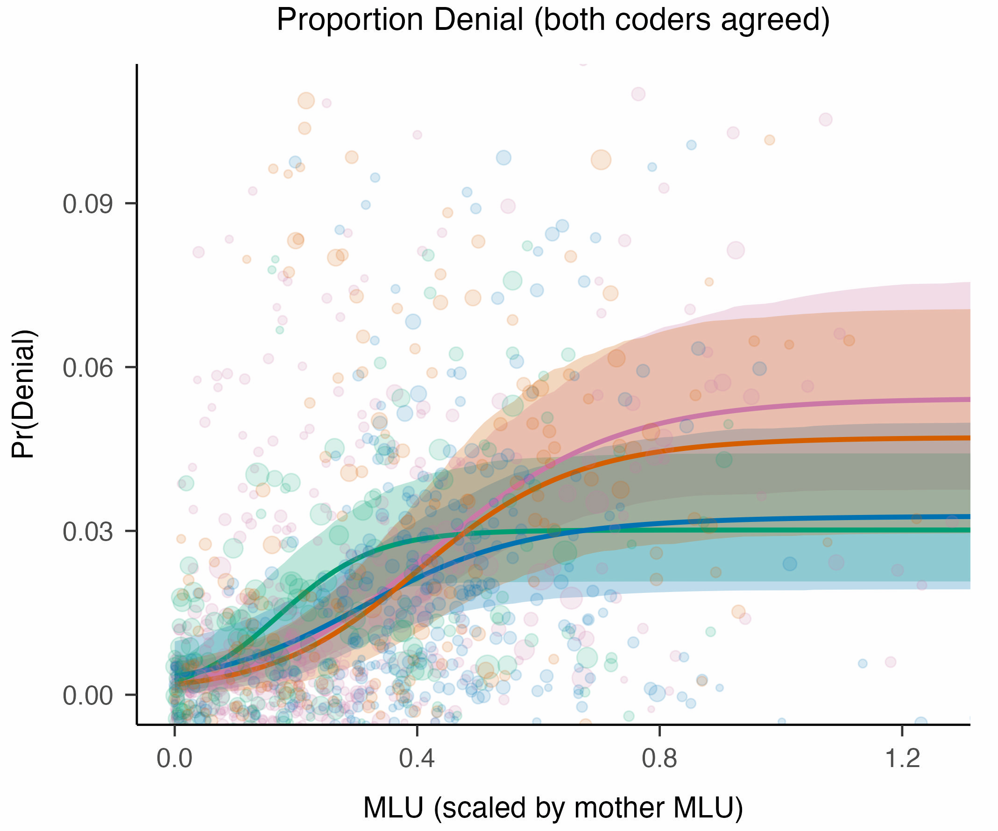
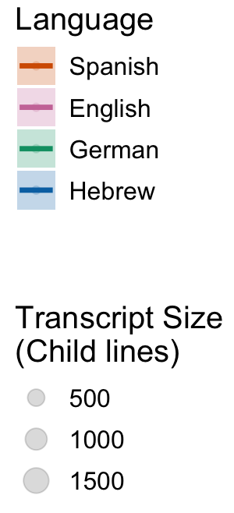
Results (Human coders)

Slide 6
Coding pipeline
Transcripts + human coding + Inter-rater reliability
child–caregiver corpora · 2 coders
Build token dataset
9,628 negator tokens + context
Evaluation splits
dev_train · dev_check_1 · dev_check_2 test_lockbox · lines_not_human_coded
Score vs. humans
agreement % · Cohen’s κ
Validated JSON output
Bloom label + 6 flags per token
LLM coding
gemma4:31b · prompt + policy + schema
error analysis → revise prompt & policy (v1 → v2 → v3)

Slide 7
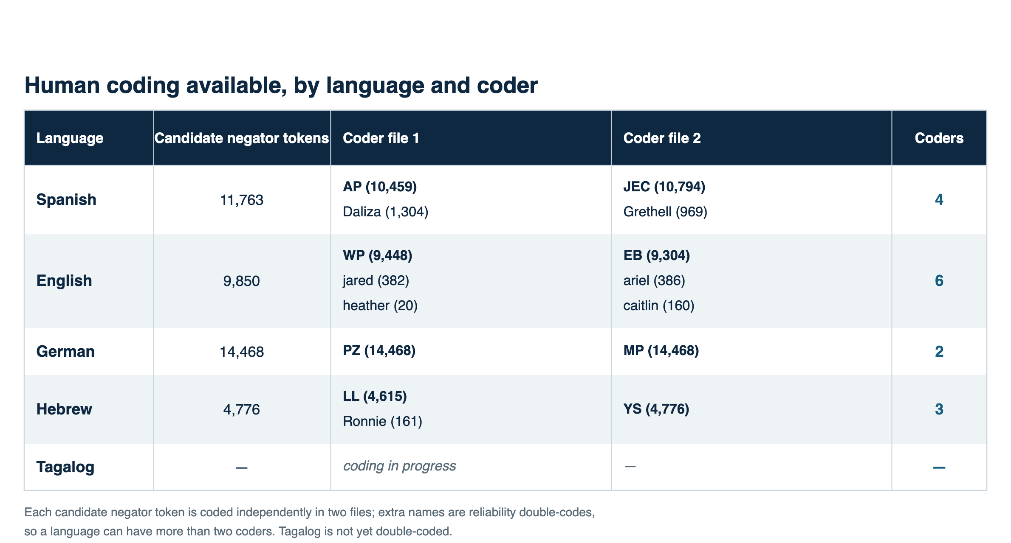

Slide 8
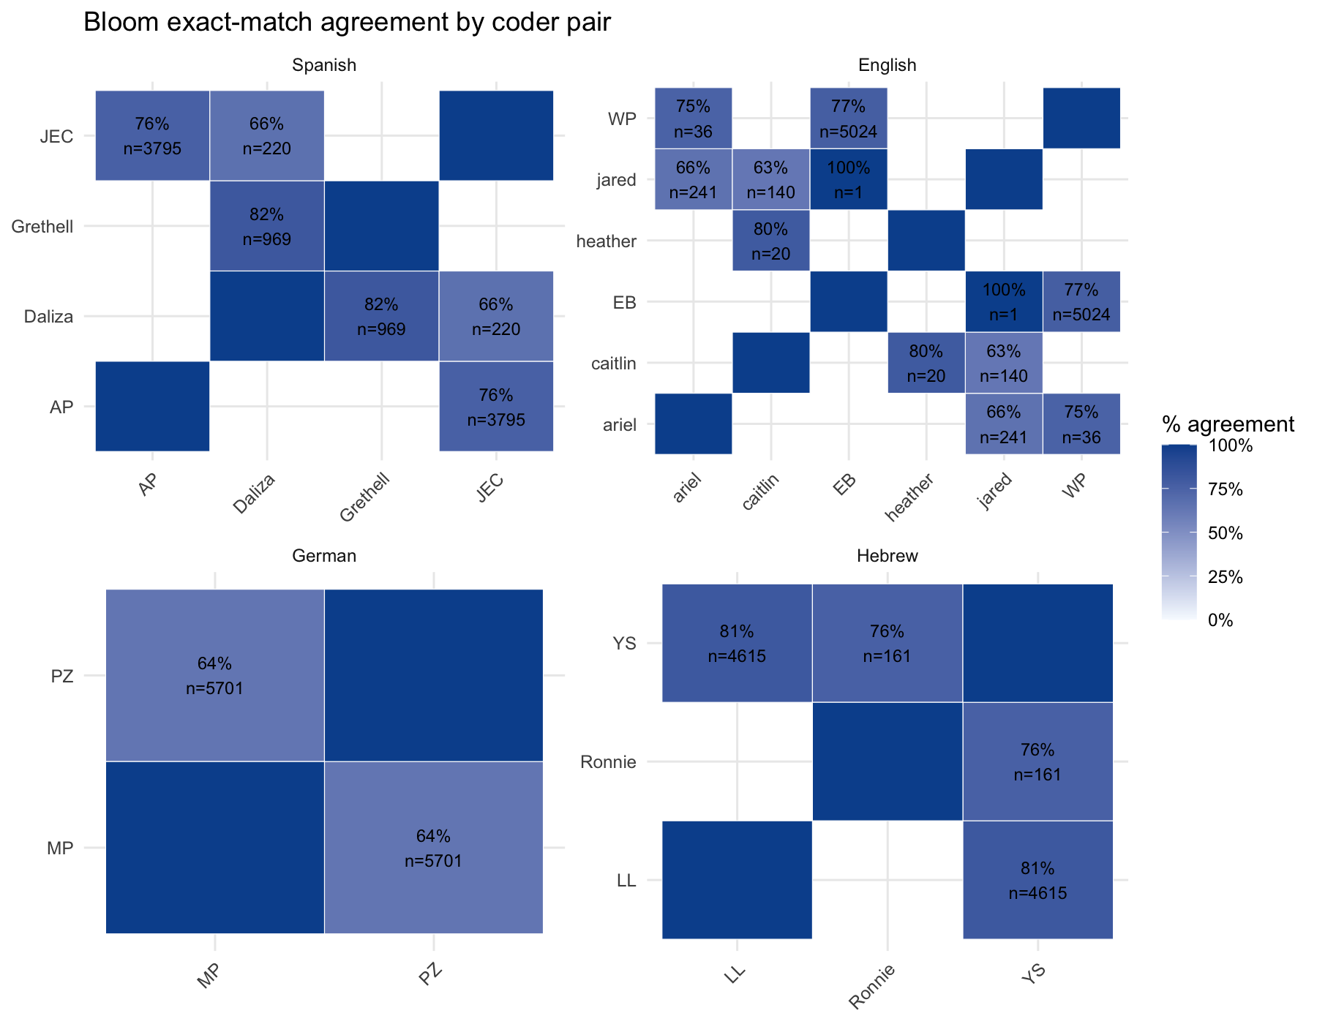
Inter-coder reliability – theoretical ceiling

Slide 9
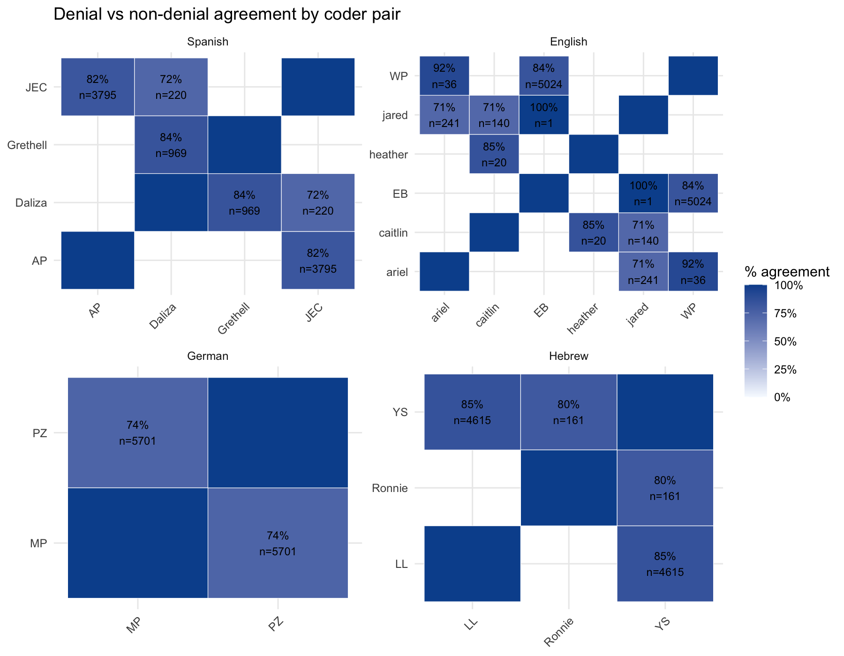
Inter-coder reliability – Denial agreement

Slide 10
Coding pipeline
Transcripts + human coding + Inter-rater reliability
child–caregiver corpora · 2 coders
Build token dataset
9,628 negator tokens + context
Evaluation splits
dev_train · dev_check_1 · dev_check_2 test_lockbox · lines_not_human_coded
Score vs. humans
agreement % · Cohen’s κ
Validated JSON output
Bloom label + 6 flags per token
LLM coding
gemma4:31b · prompt + policy + schema
error analysis → revise prompt & policy (v1 → v2 → v3)

Slide 11
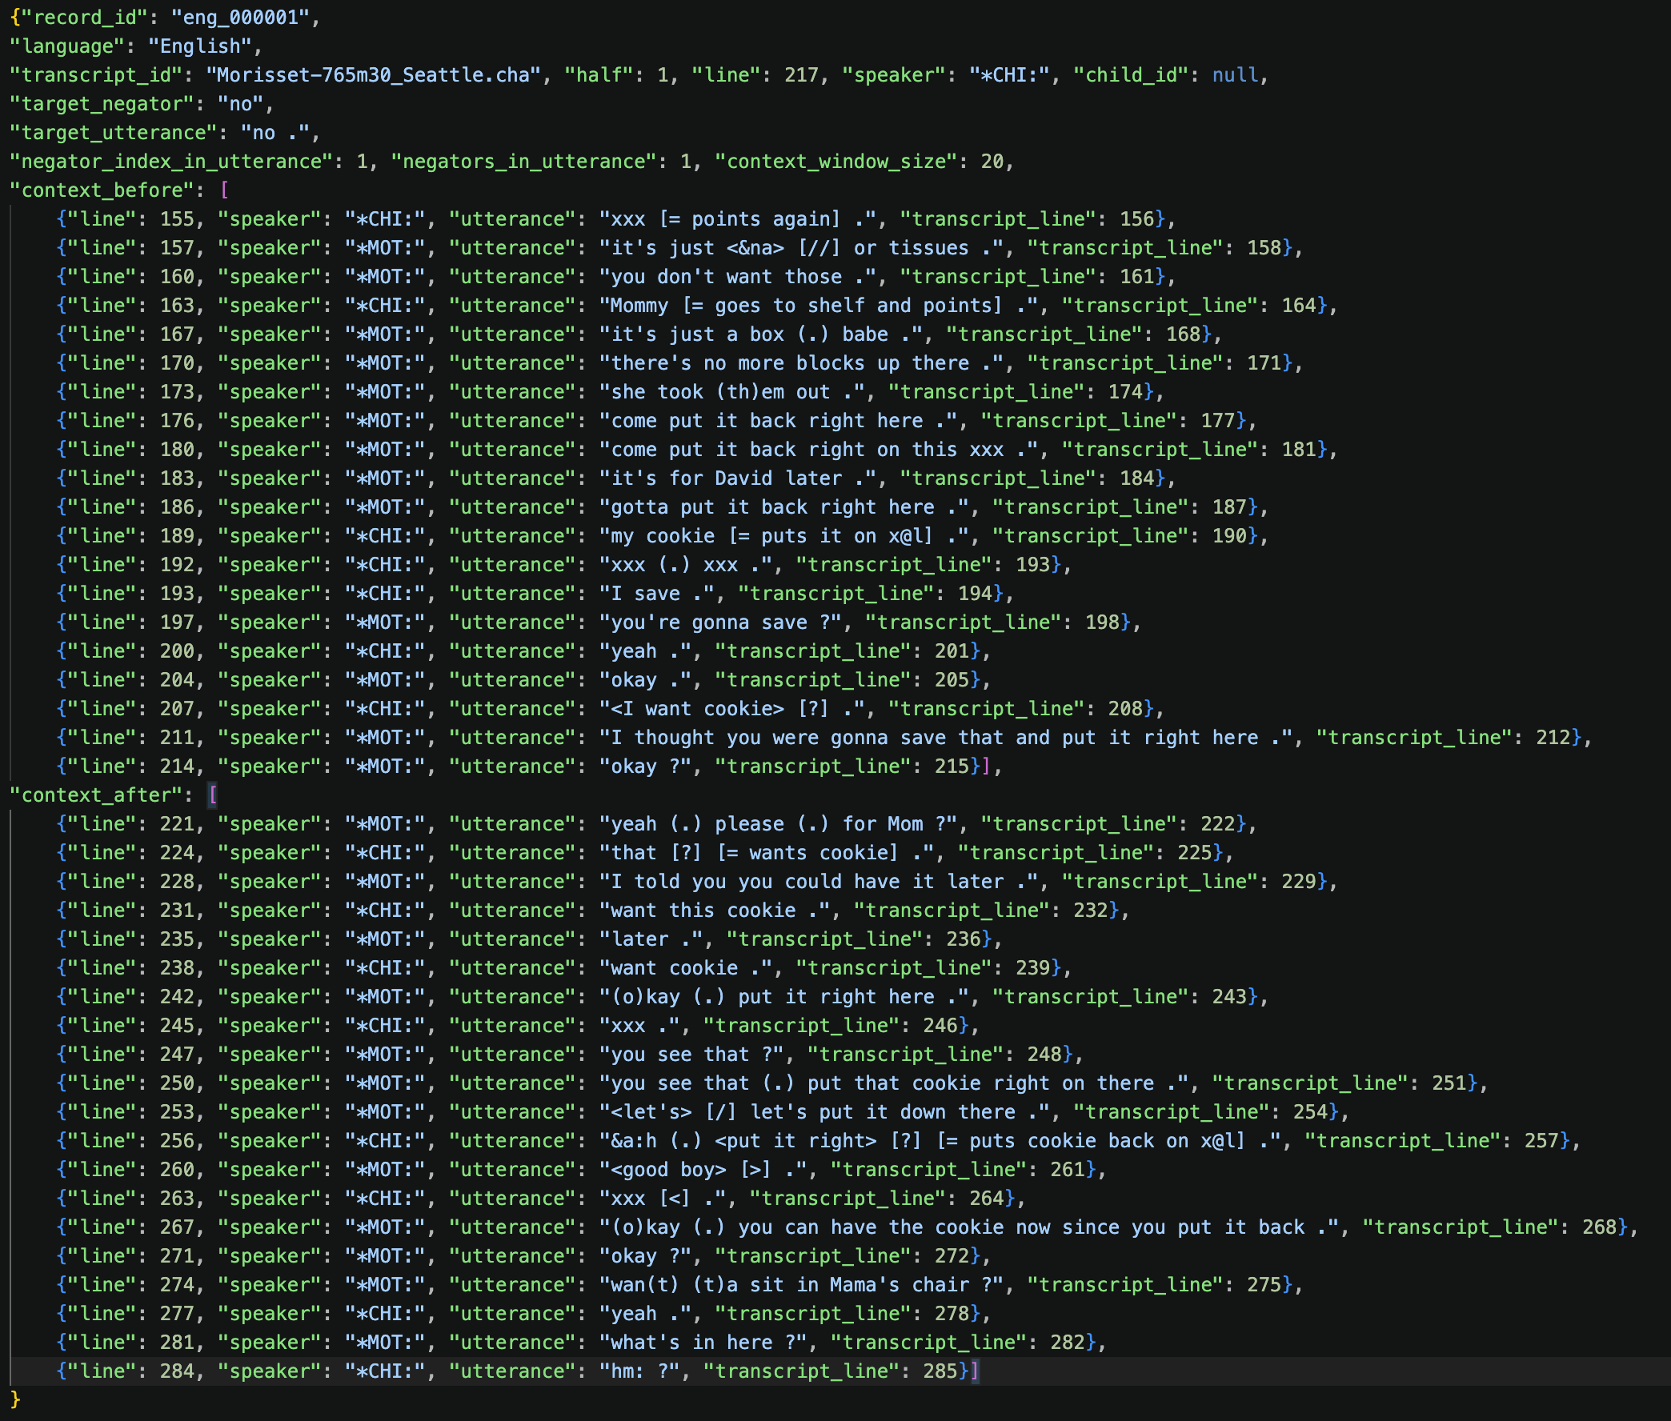
…
…

Slide 13
Coding pipeline
Transcripts + human coding + Inter-rater reliability
child–caregiver corpora · 2 coders
Build token dataset
9,628 negator tokens + context
Evaluation splits
dev_train · dev_check_1 · dev_check_2 test_lockbox · lines_not_human_coded
Score vs. humans
agreement % · Cohen’s κ
Validated JSON output
Bloom label + 6 flags per token
LLM coding
gemma4:31b · prompt + policy + schema
error analysis → revise prompt & policy (v1 → v2 → v3)

Slide 14
Split criteria
Split | Target Proportion
dev train | 20%
dev check 1 | 25%
dev check 2 | 25%
test lockbox | 30%
Similar proportion 2 vs. 1 coders
And similar proportion of each individual coder
Similar IRR distribution
Similar child age distribution

Slide 15
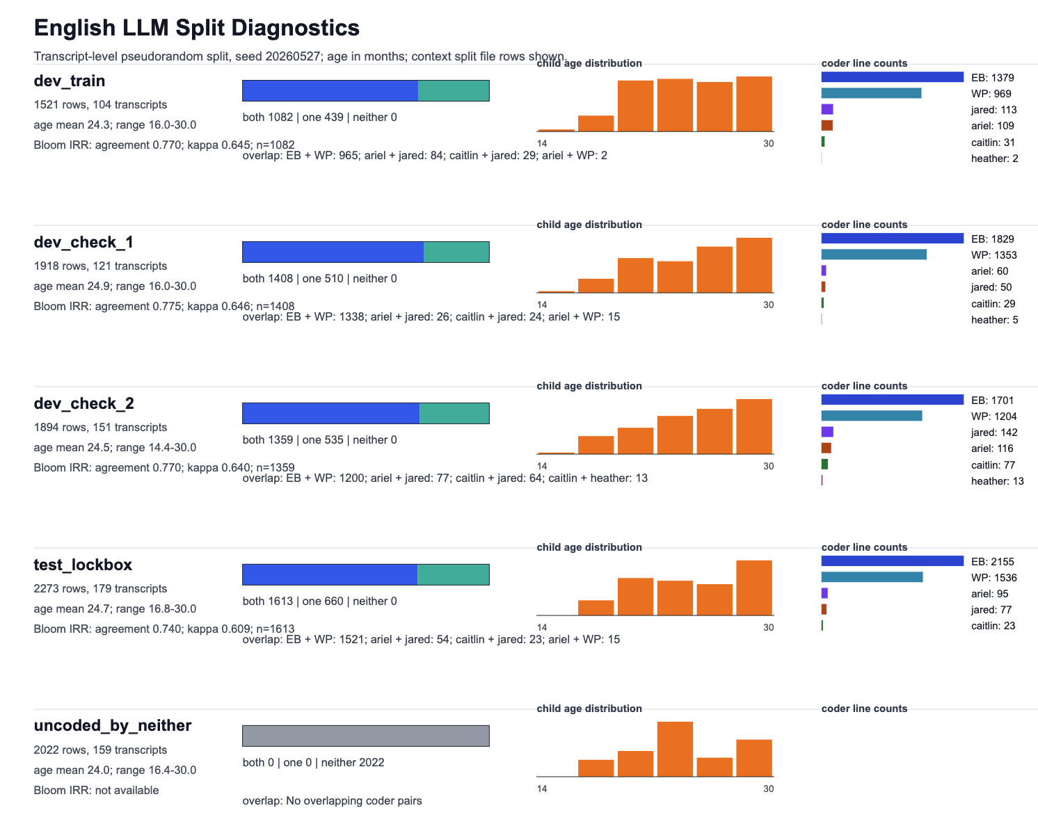

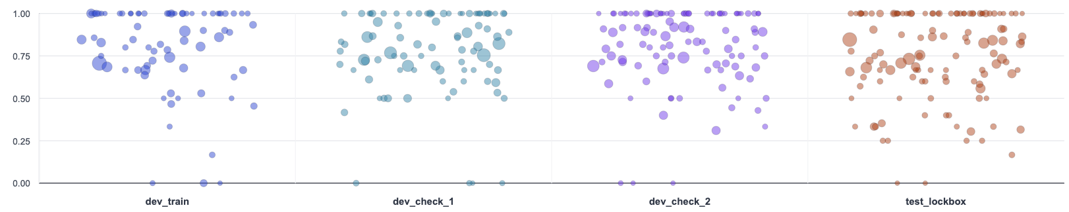

Slide 16
Coding pipeline
Transcripts + human coding + Inter-rater reliability
child–caregiver corpora · 2 coders
Build token dataset
9,628 negator tokens + context
Evaluation splits
dev_train · dev_check_1 · dev_check_2 test_lockbox · lines_not_human_coded
Score vs. humans
agreement % · Cohen’s κ
Validated JSON output
Bloom label + 6 flags per token
LLM coding
gemma4:31b · prompt + policy + schema
error analysis → revise prompt & policy (v1 → v2 → v3)

Slide 17
Prompt structure
System instructions/task
Step 0: decide if it’s a negation
Bloom coding rules
Decision heuristics
Use participants as your guide
Rejection vs. Denial
Negative imperatives
Uncoded vs. Excluded
Flag rules – mimicry, repetition, foreign language negation, not a negation, tag question
Decide first, then write
Output contract
Examples
Batch input instructions

Slide 18
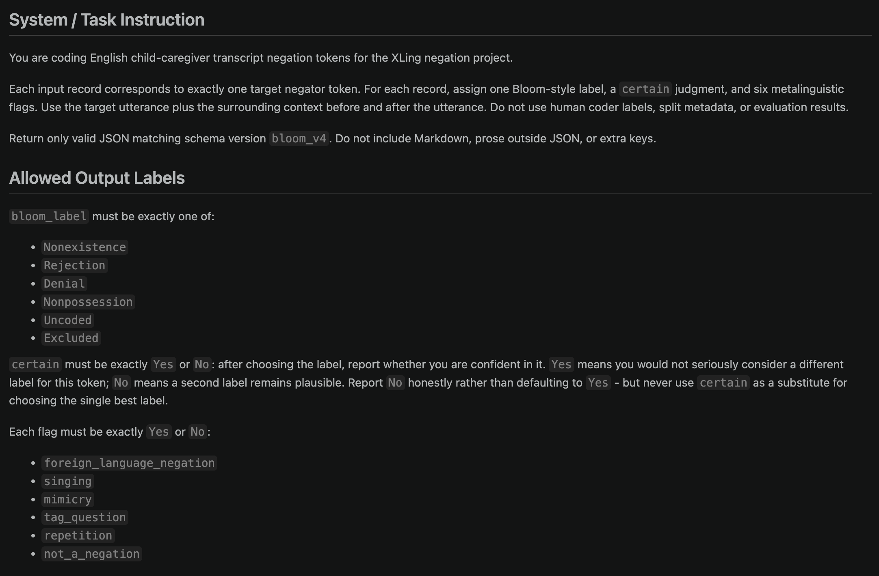
Prompt v4

Slide 19
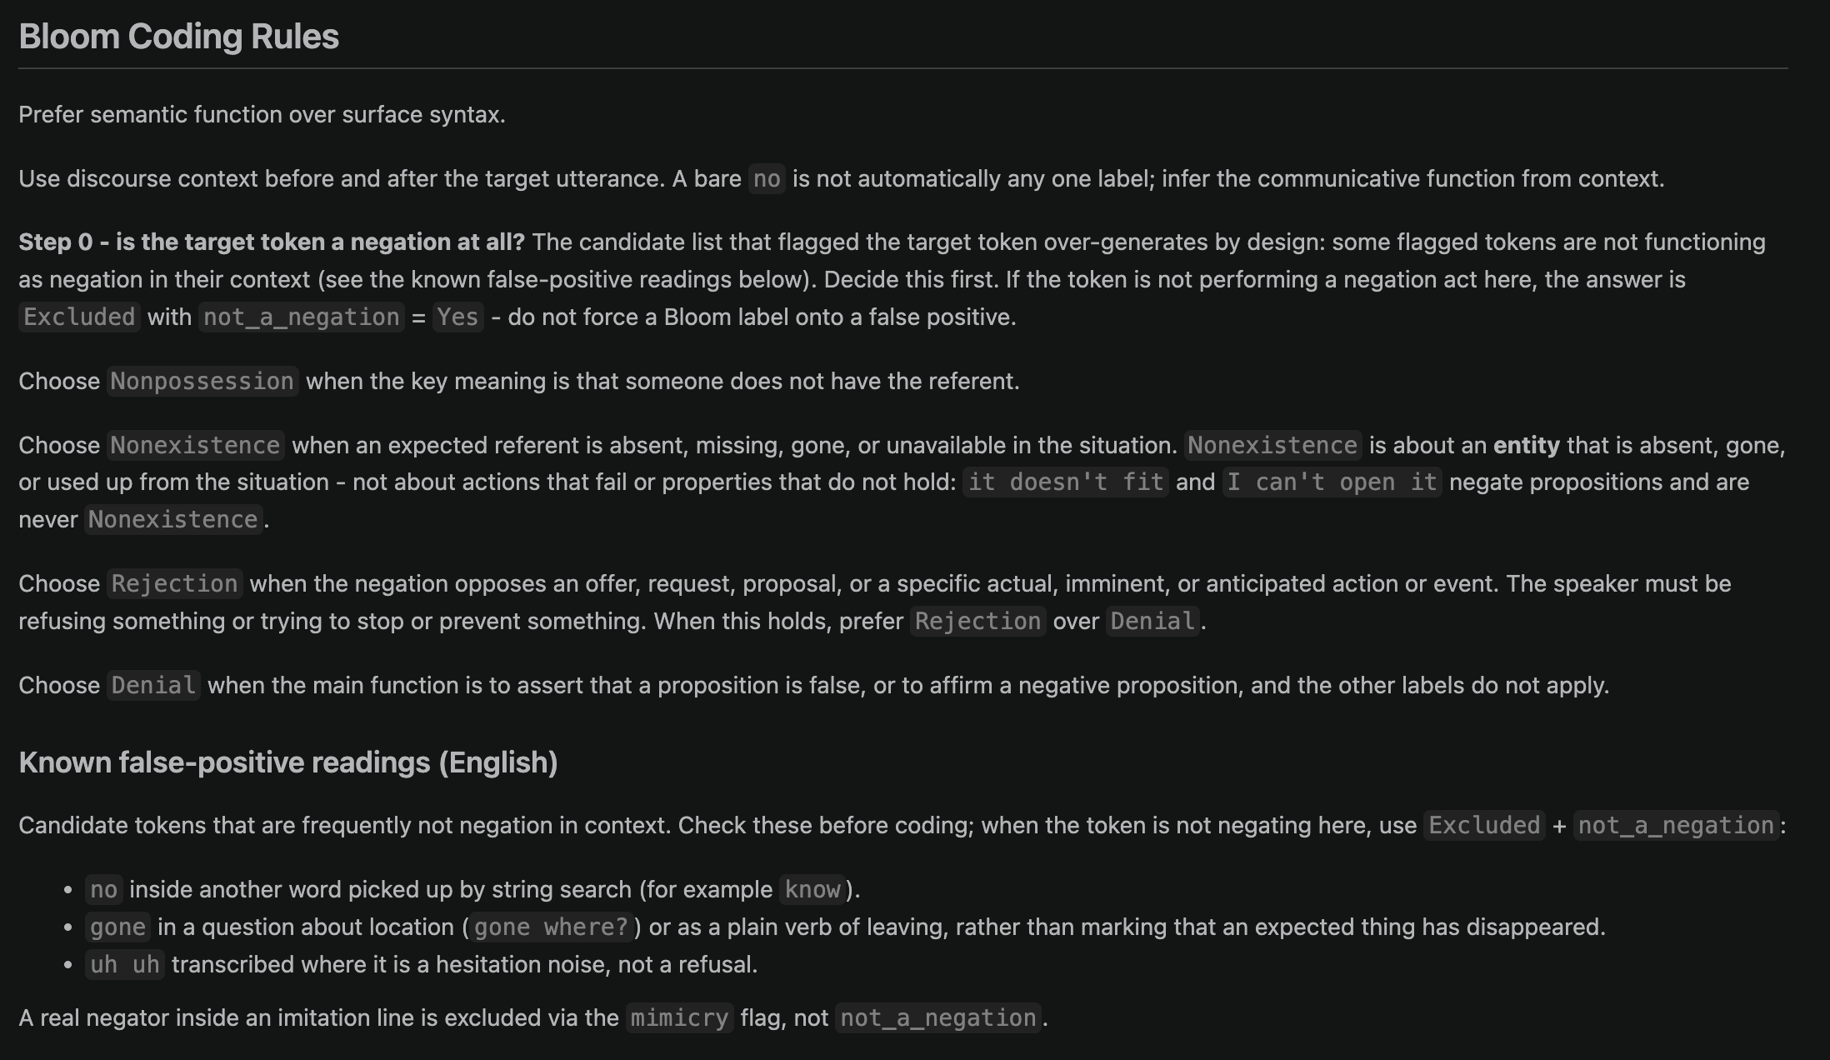
Prompt v4

Slide 20
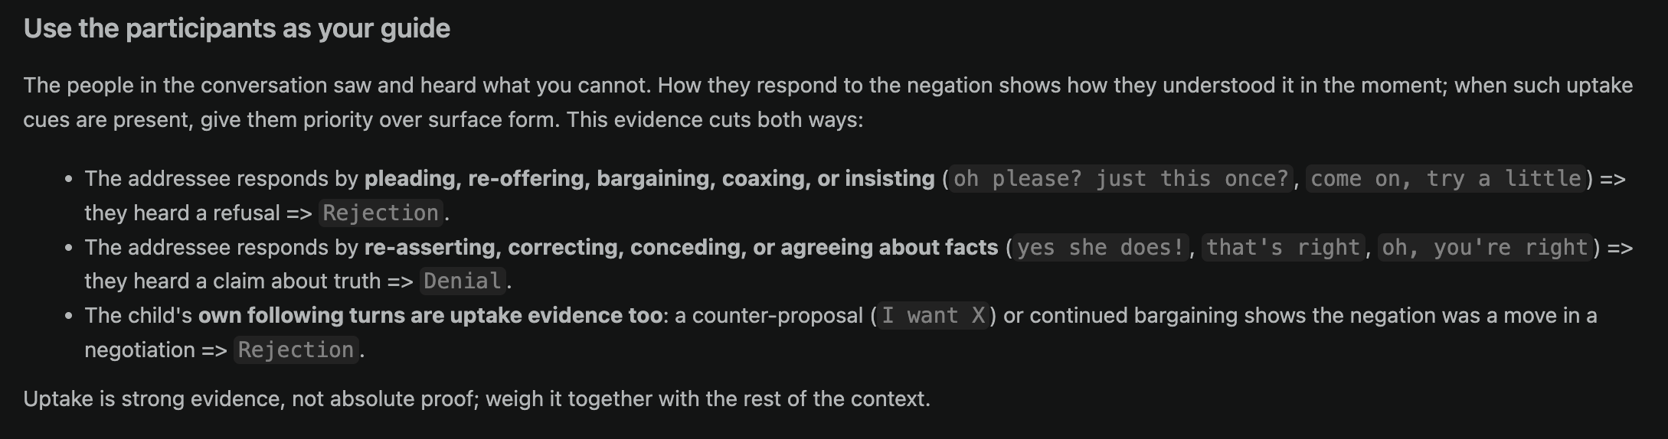
Prompt v4

Slide 21
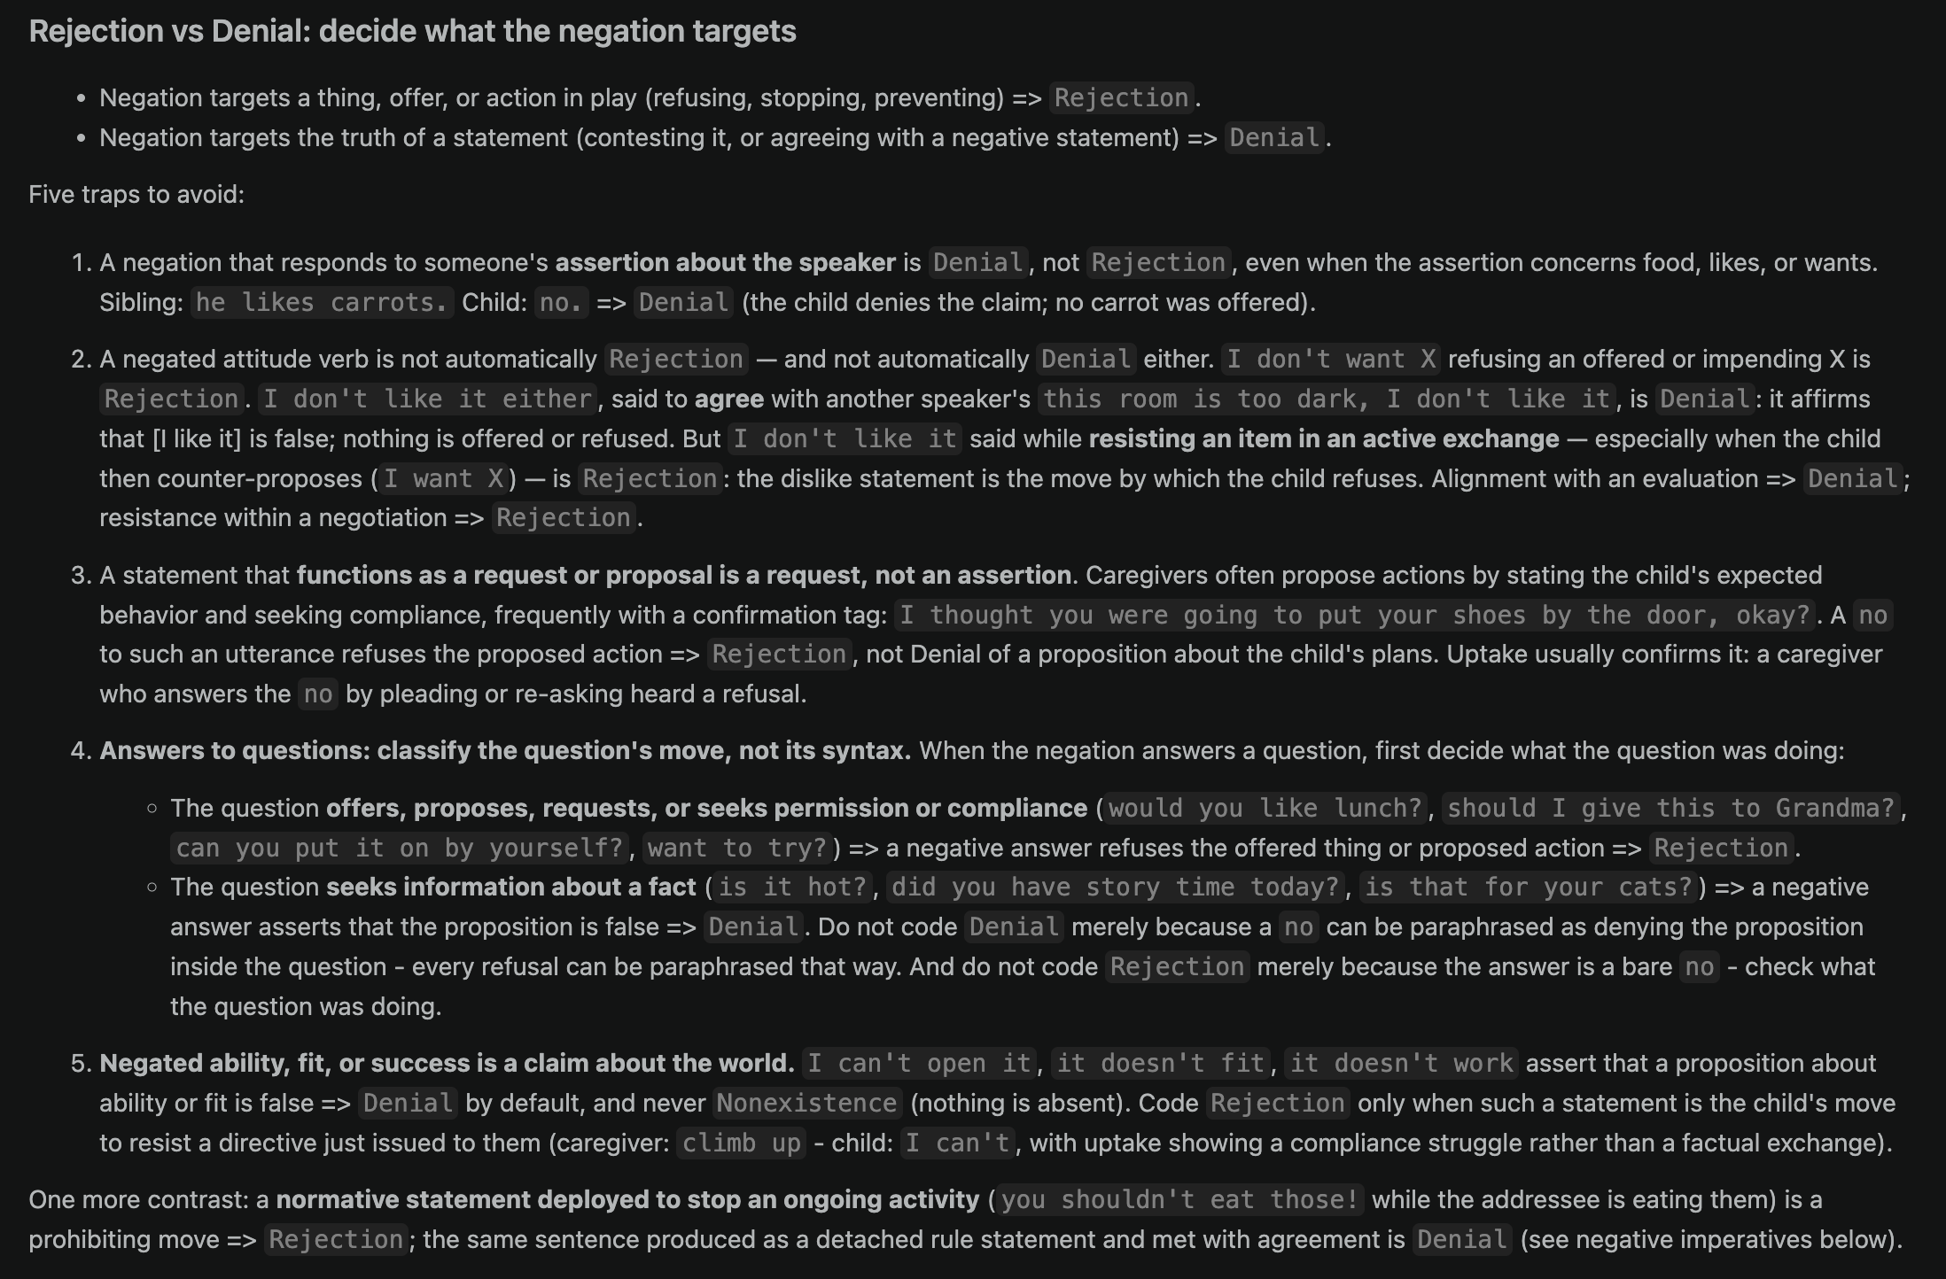
Prompt v4

Slide 22
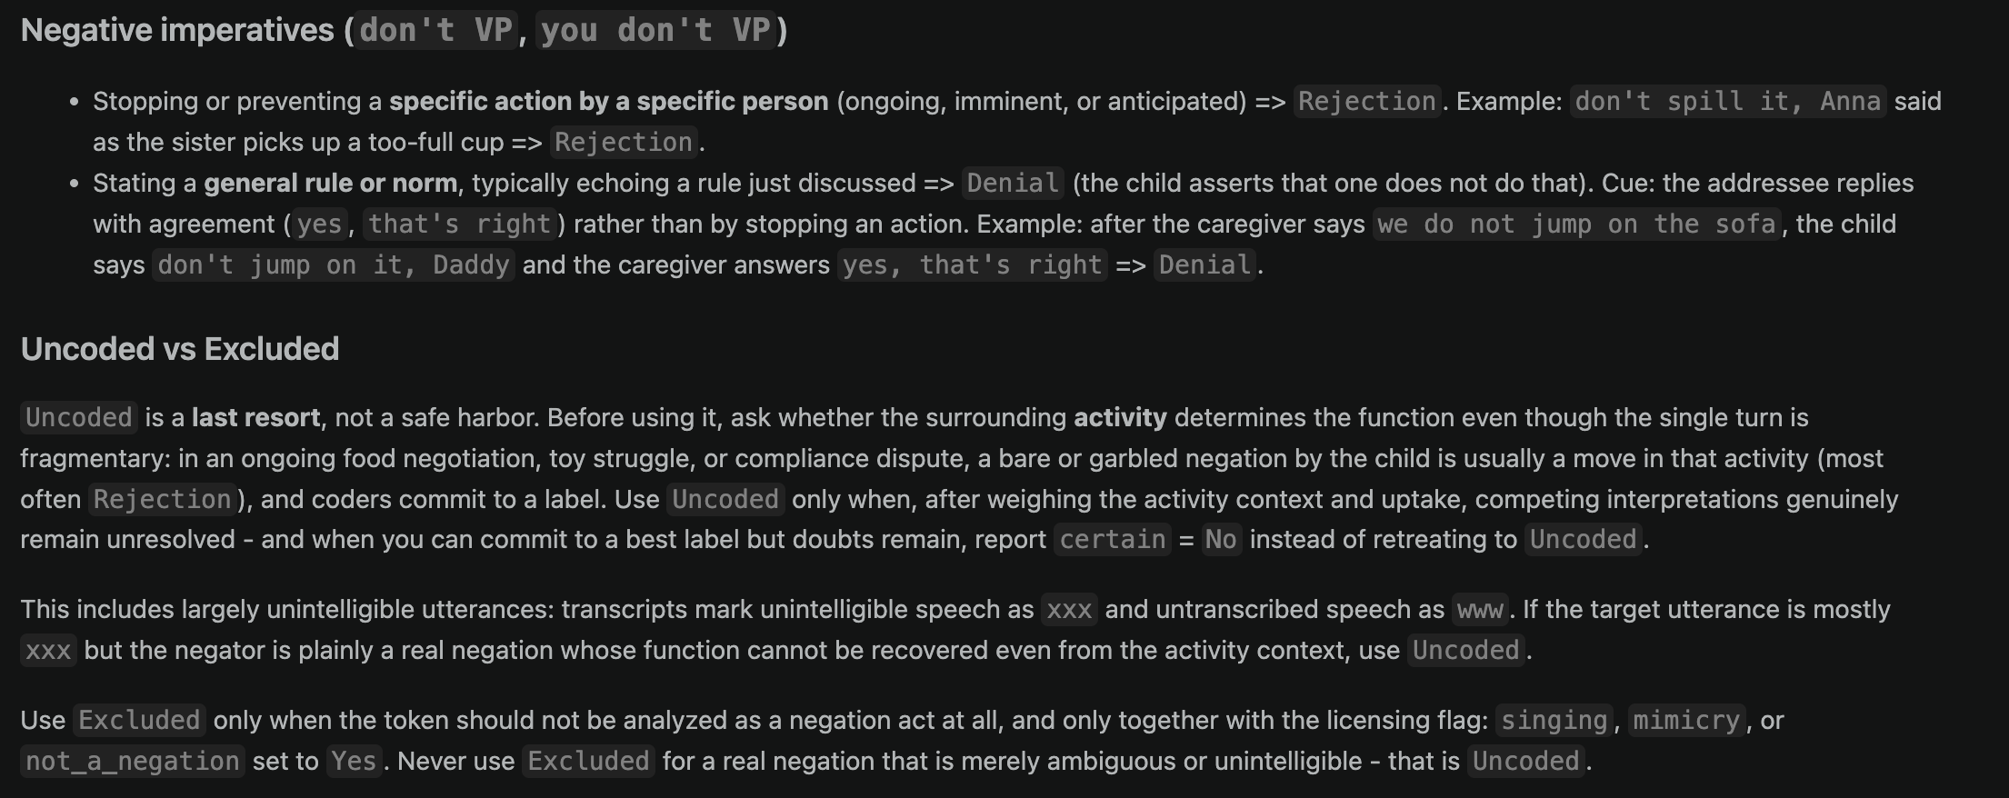
Prompt v4

Slide 23
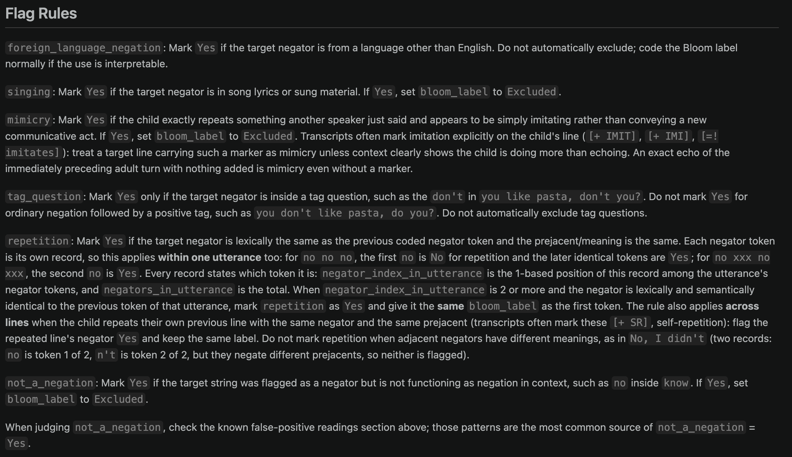
Prompt v4

Slide 24
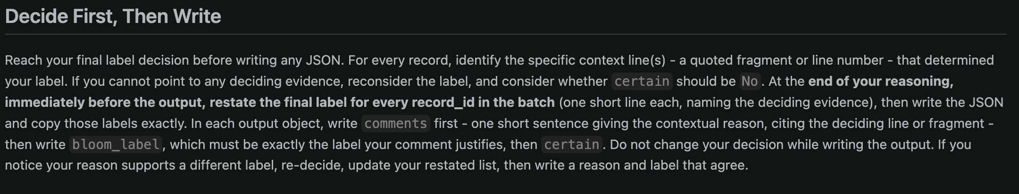
Prompt v4

Slide 25
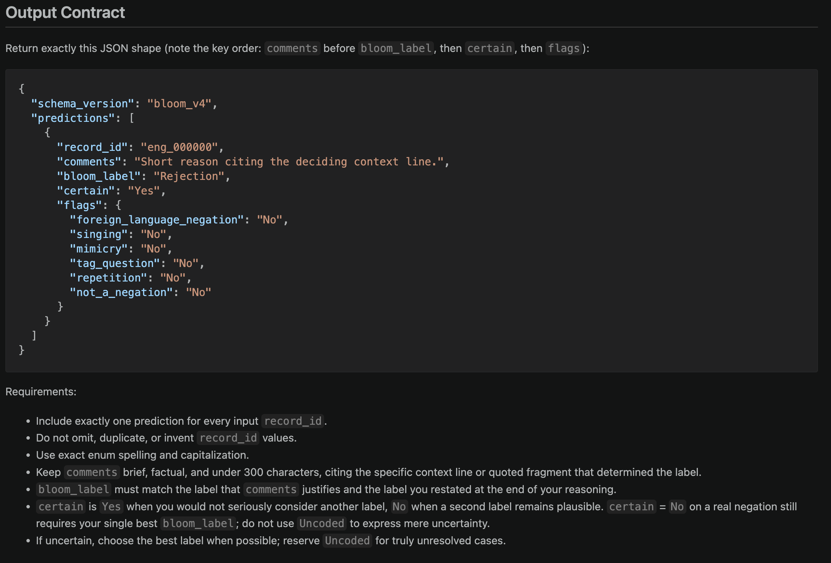
Prompt v4

Slide 26
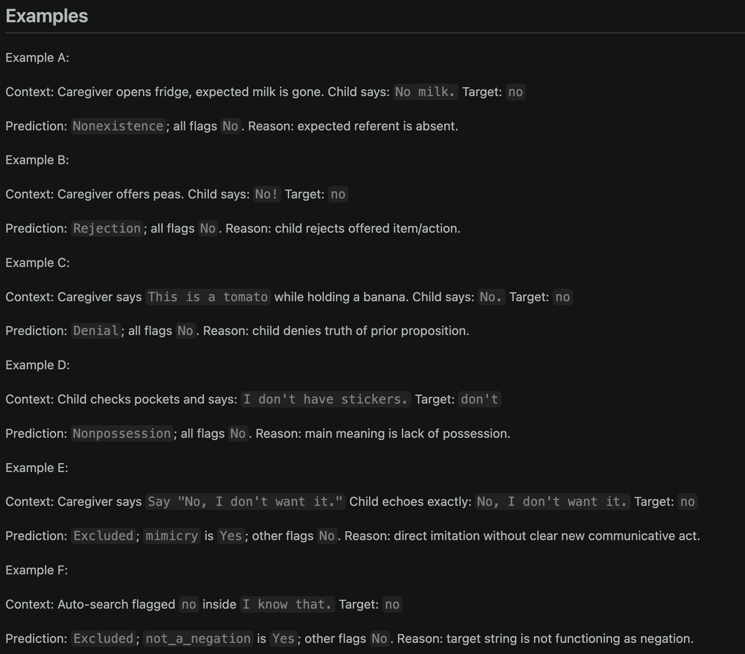
Prompt v4

Slide 27
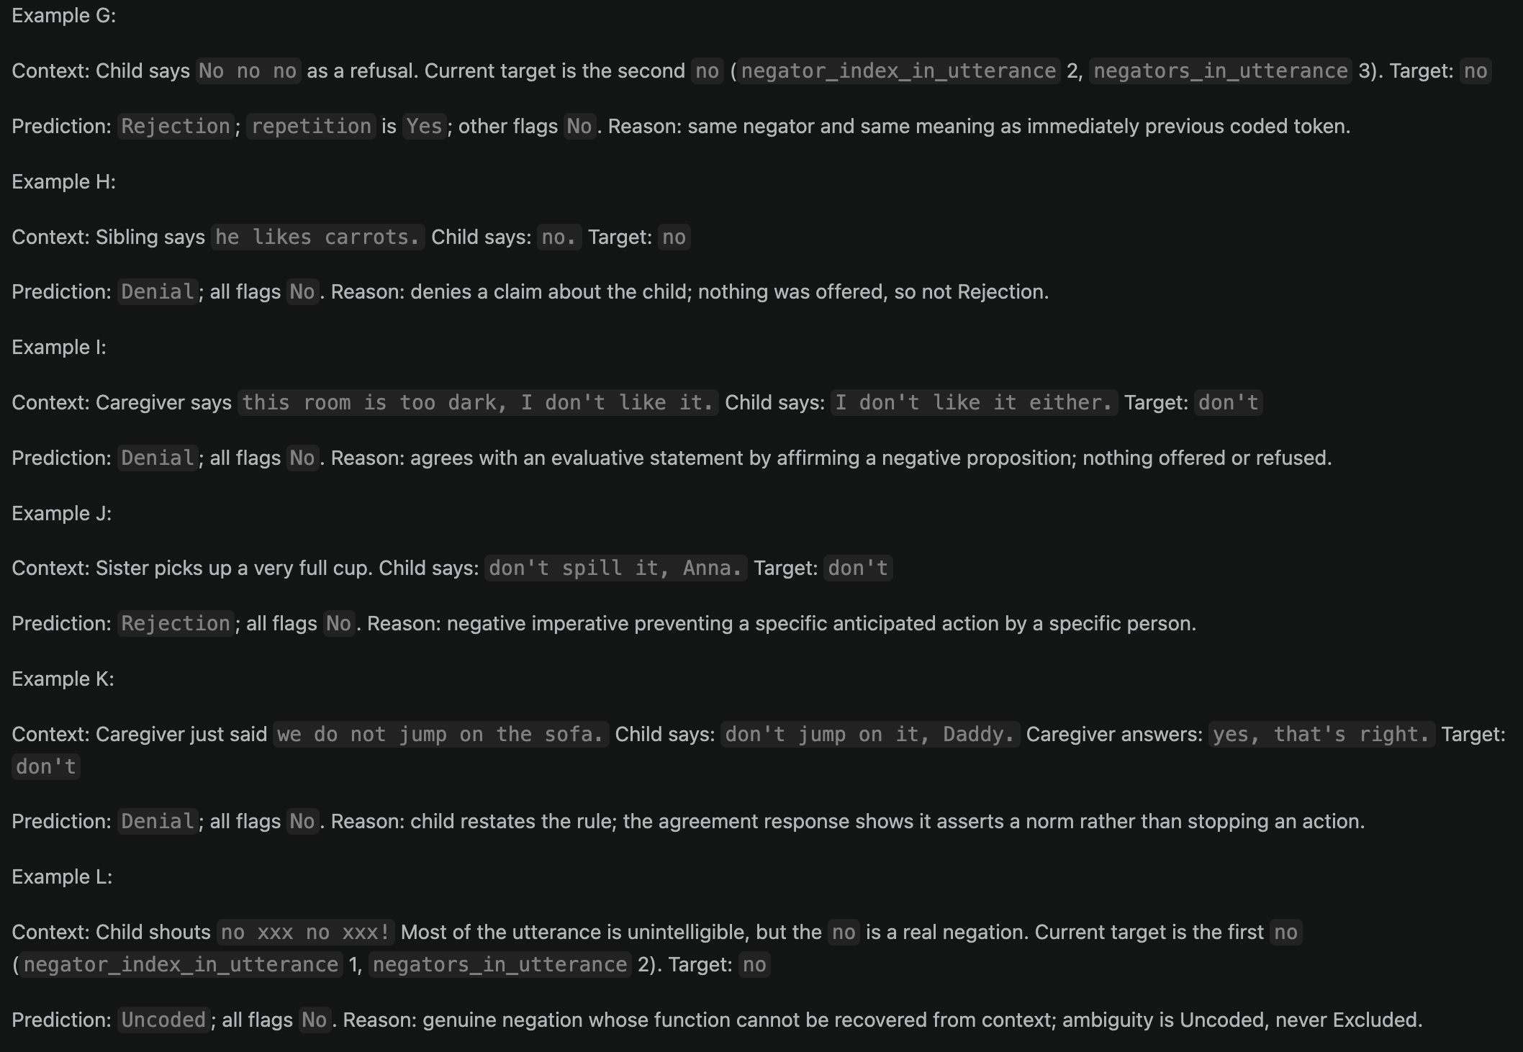
Prompt v4

Slide 28
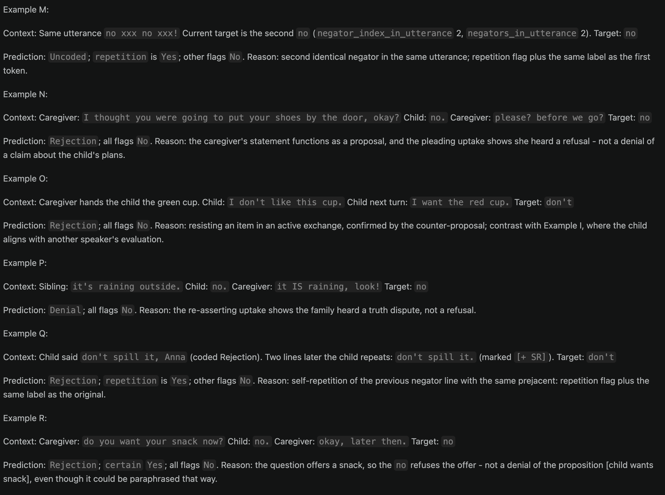
Prompt v4

Slide 29
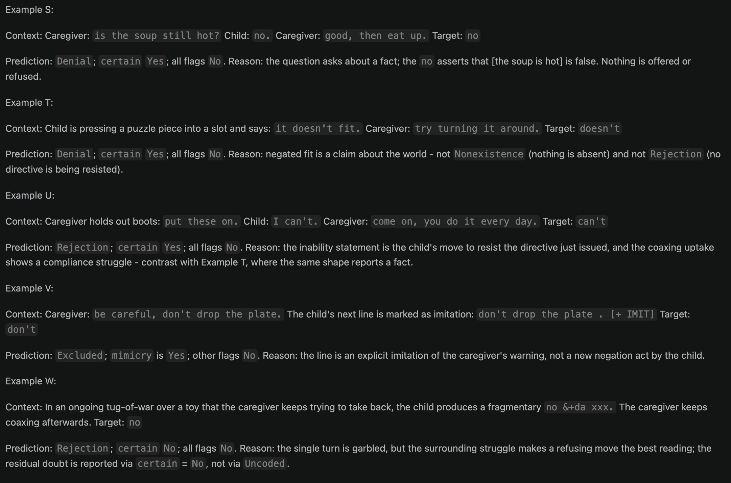
Prompt v4

Slide 30
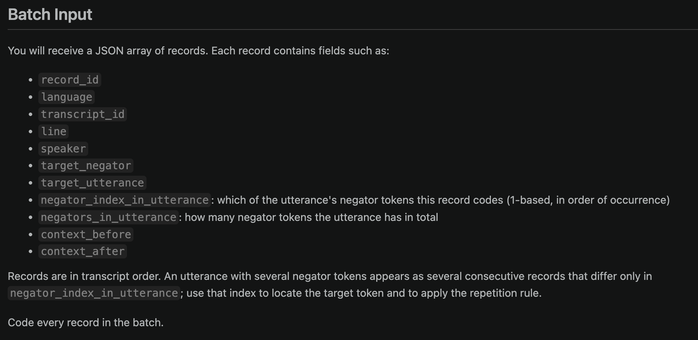
Prompt v4

Slide 31
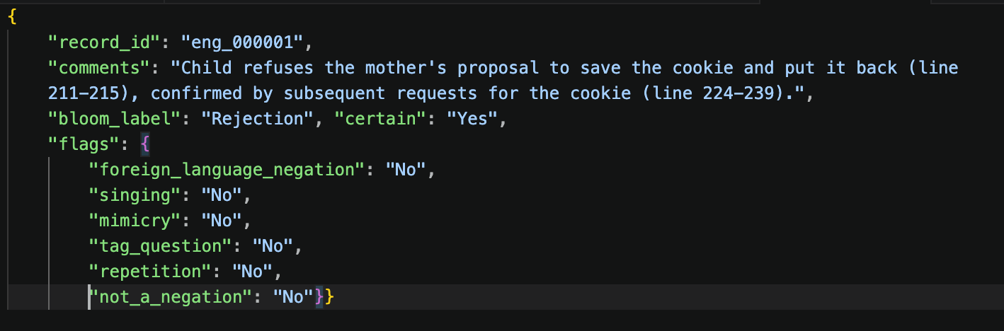
Example output

Slide 32
Changes to get to v4
v1 → v2
Input
Add line in input dataset numbering the negations in an utterance—allows model to identify repetitions
Output
Comments before label
Prompt
Clarify distinction between refusing and correcting
Clarify distinction between imperative and deontic don’t
Clarify Uncoded criteria
Added examples BUT the added examples were precisely the lines to be coded -- lol
v2 → v3
Prompt
Focus on interlocutor responses in coding decisions
Note that request speech acts can look like statements
Statements of opinion in an offering context are often refusals
Decide first, write final decision at end of reasoning, then output
Fix example contamination

Slide 33
Changes to get to v4
v3 → v4
New Step 0: decide whether the target token is a negation before assigning a function label
Nonexistence tightened: only absent/gone/used-up entities; failed actions and non-holding properties are never Nonexistence.
New Rejection-vs-Denial rules:
classify the question’s speech act, not its syntax — offer/proposal/permission/compliance question → Rejection; fact question → Denial
Negated ability/fit/success → Denial by default, never Nonexistence; Rejection only as resistance to a just-issued directive (uptake test)
Normative-statement note: used to stop an ongoing activity → Rejection; detached rule met with agreement → Denial
Uncoded demoted to last resort: commit to the label when context determines it, and put residual doubt in certain = No.
Mimicry flag: explicit imitation markers ([+ IMIT], [+ IMI], [=! imitates]) and exact echoes of the prior adult turn → Excluded
Comments must cite the deciding context line (handles llama's context-free "child refuses" comments).
New required Certain field (Yes/No), emitted after Bloom label — mirrors the human coders’ certainty column; binary (not numeric) because verbalized LLM confidences are poorly calibrated

Slide 34
Masking
Some languages have more lexical signals to negator meaning
How much of coding is lexical vs. context-driven?
Run two versions: full transcript and negator masked
[MASKED]
“[MASKED] Mommy.”

Slide 35
Models
gemma4:31b
qwen3:32b
llama3.3:70b
No official Hebrew or Tagalog support
Failed at some masked and some Tagalog runs– redoing now with different seed

Slide 36

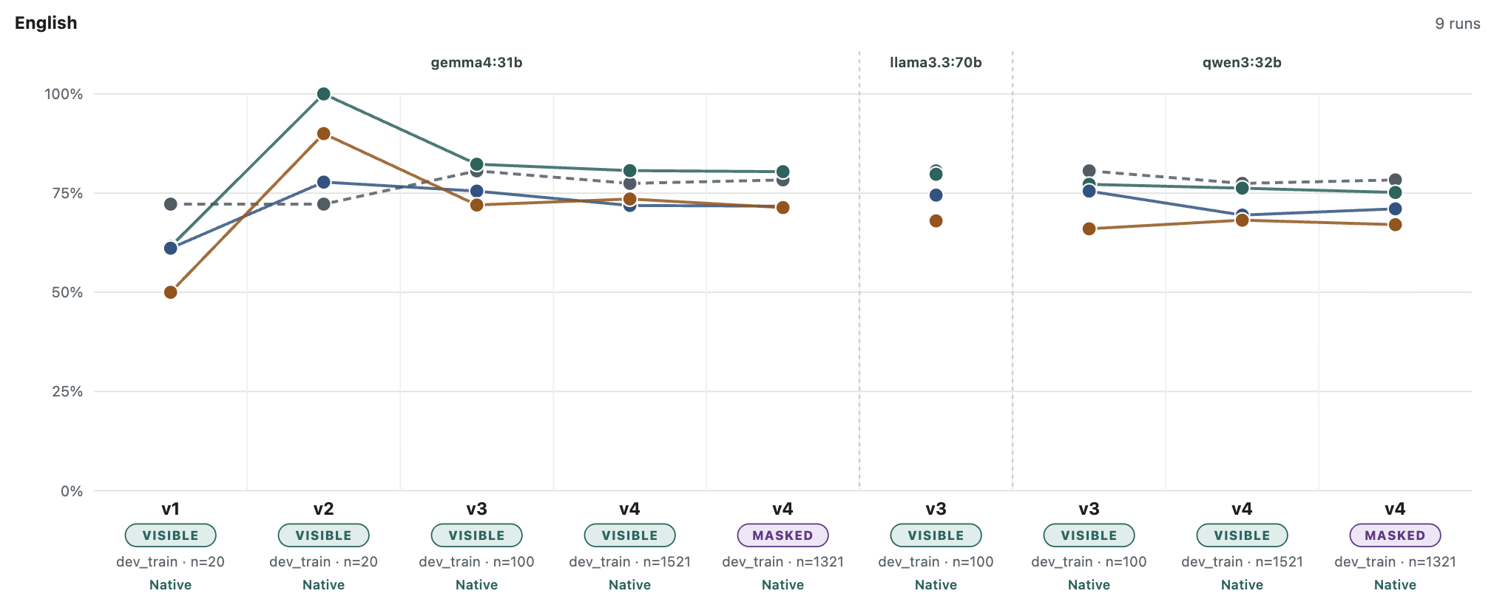
LLM–human agreement across versions : English
Prompt contaminated

Slide 37
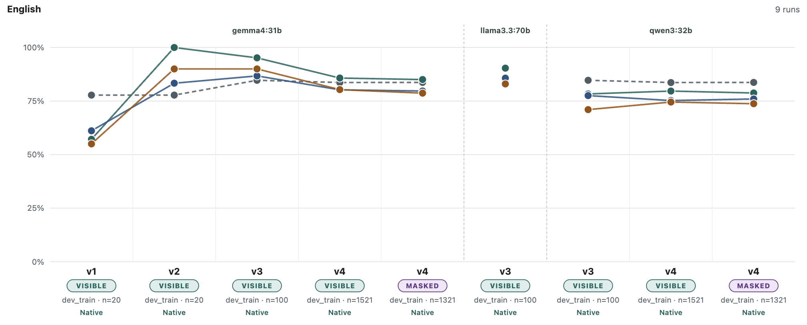
LLM–human agreement across versions : English; denial vs. not denial
Prompt contaminated

Slide 38
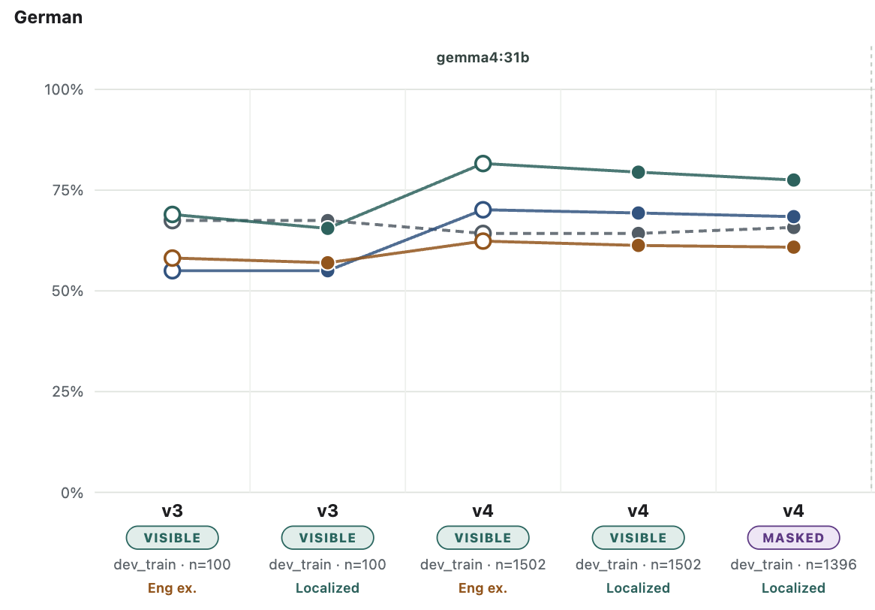
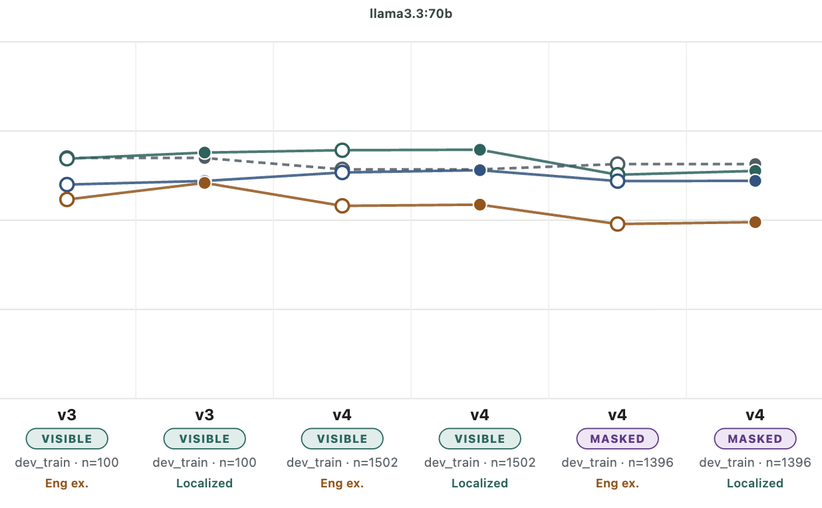
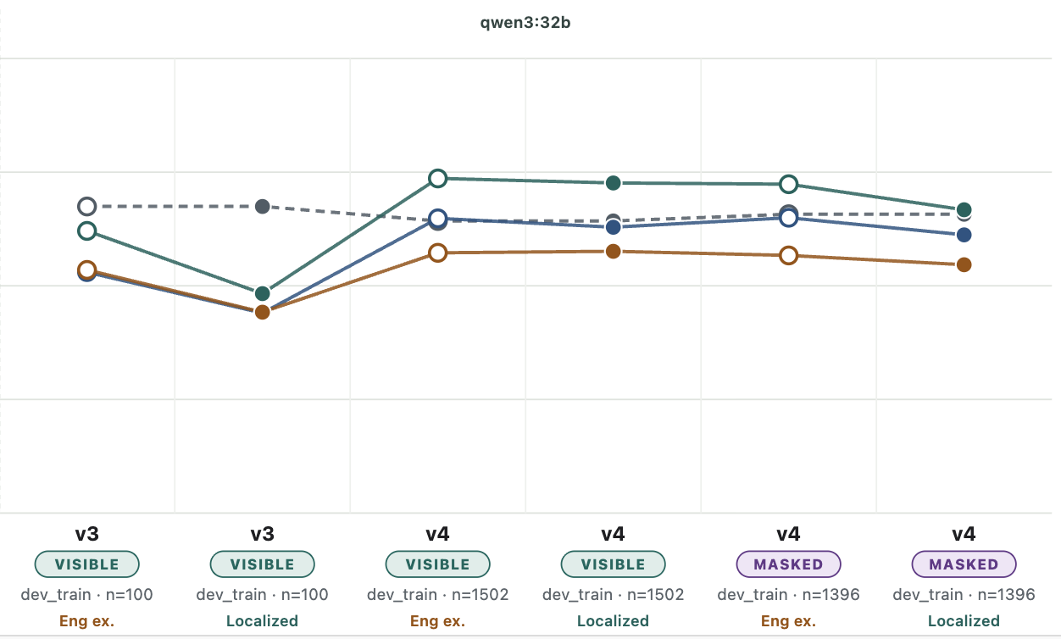
German all categories

Slide 39
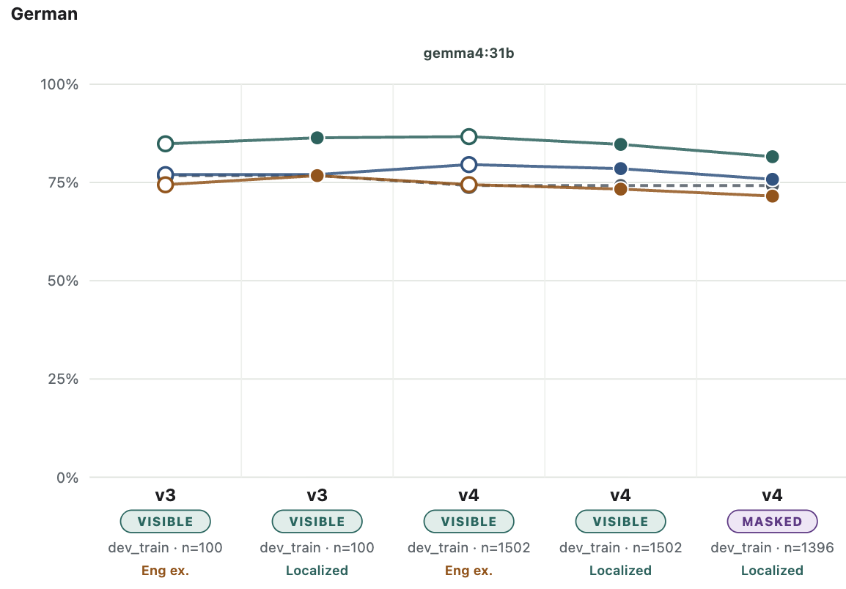
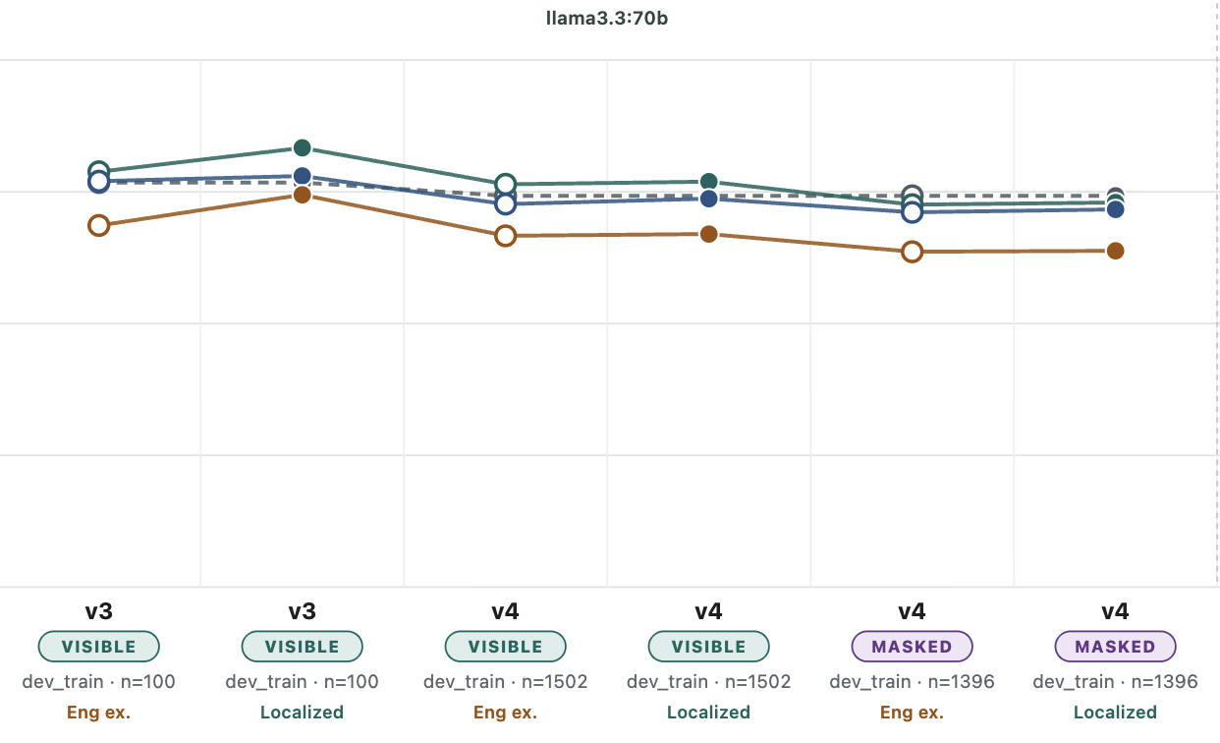
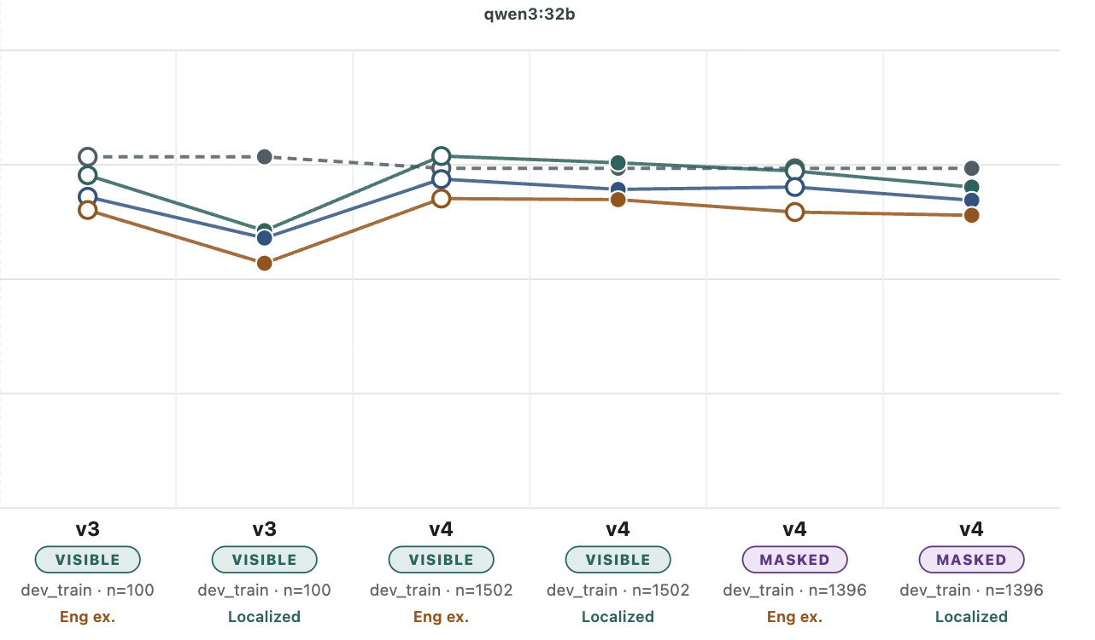
German Denial vs. not denial

Slide 40
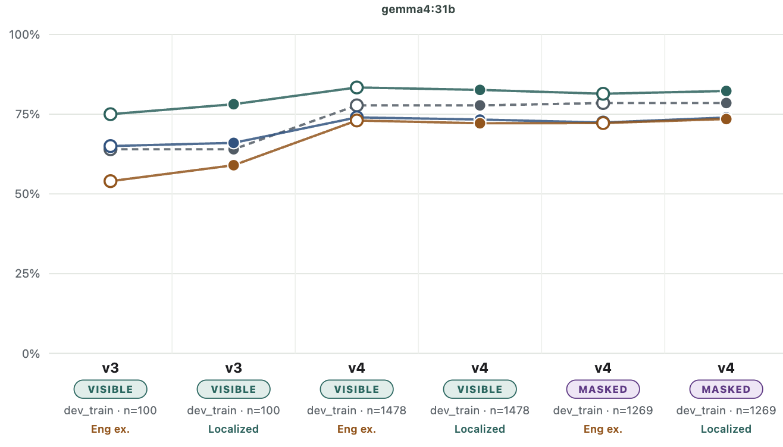
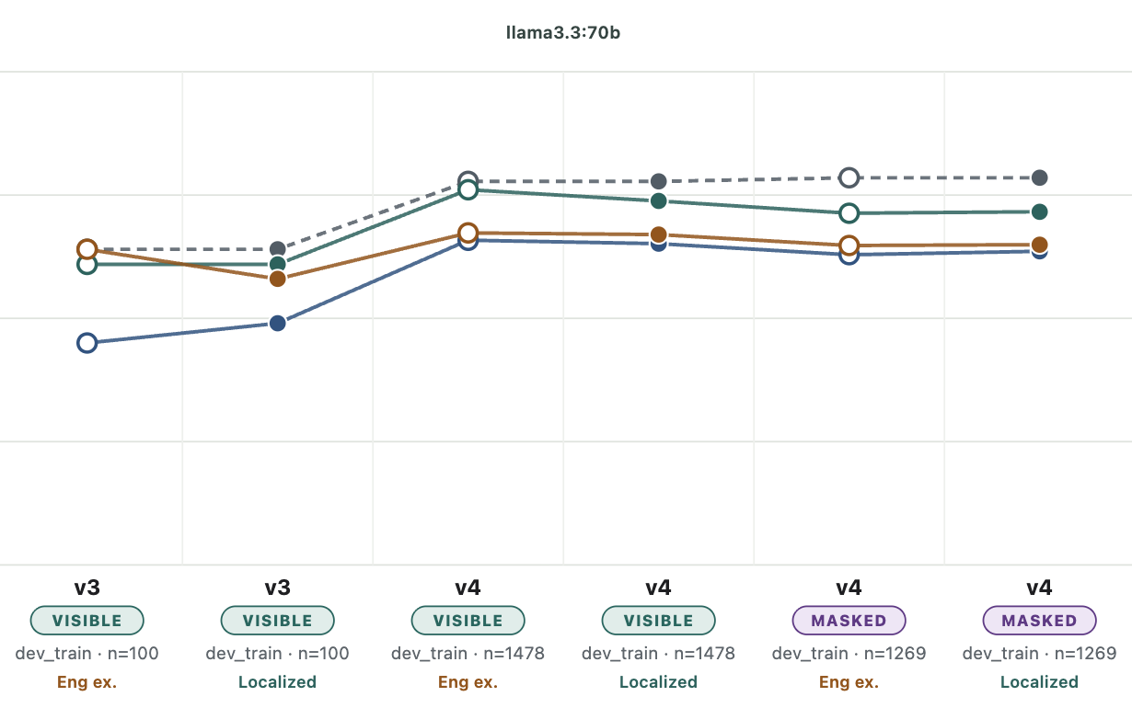
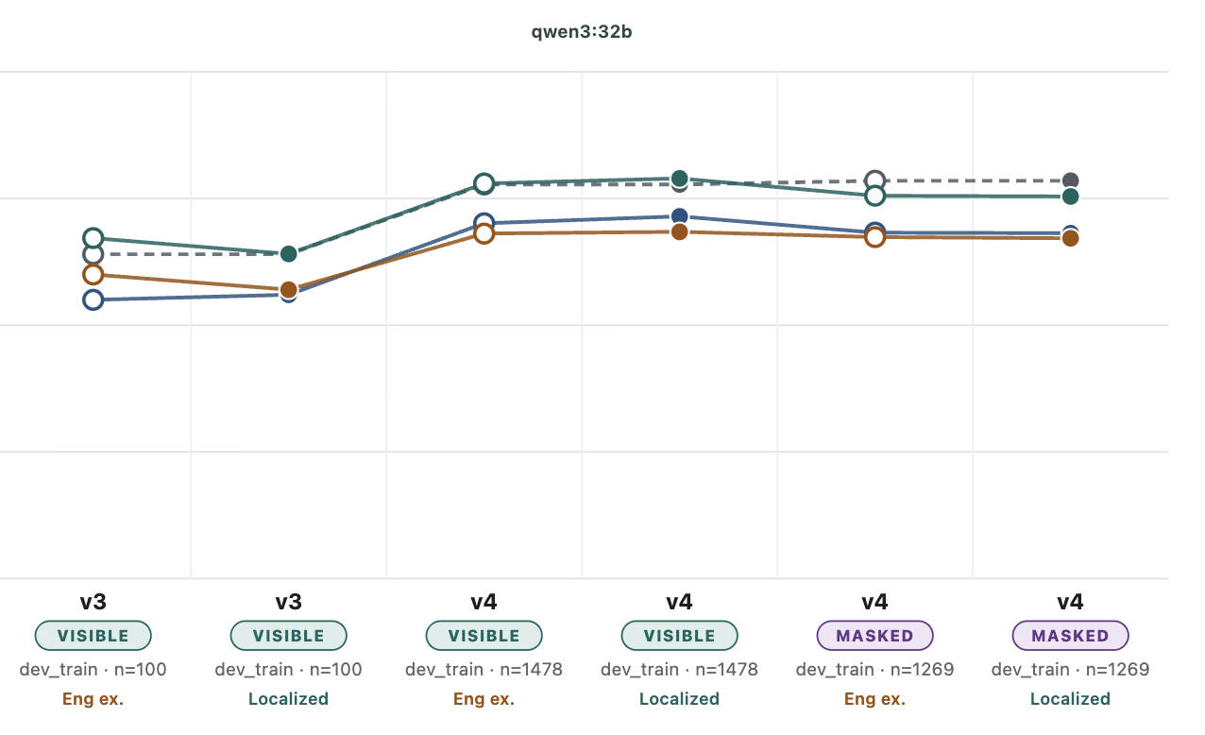
Spanish all categories

Slide 41
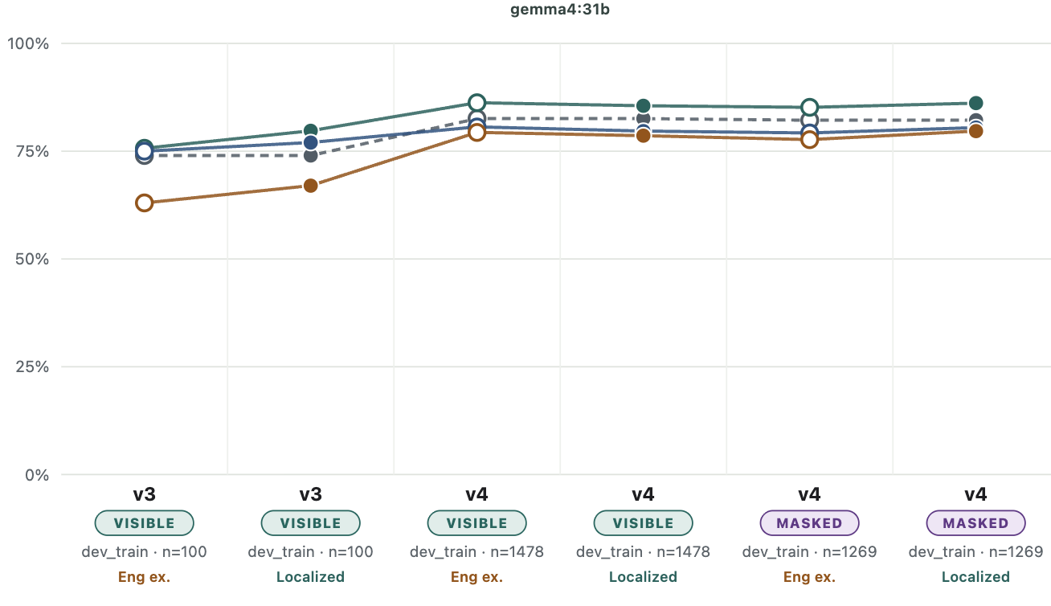
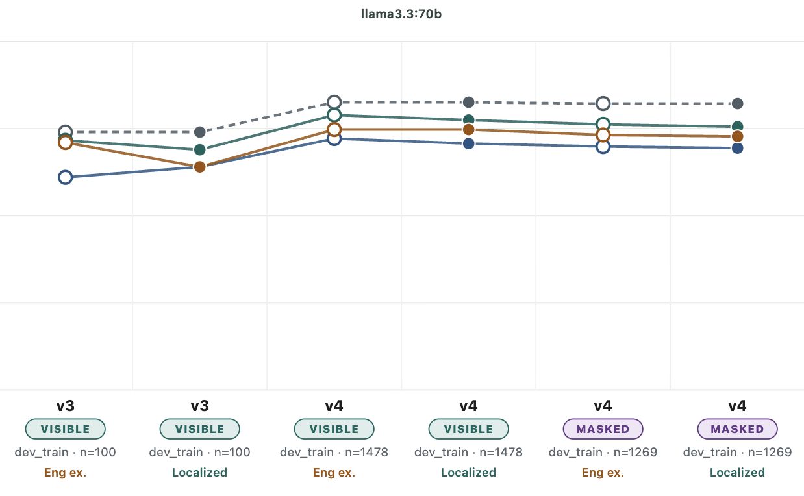
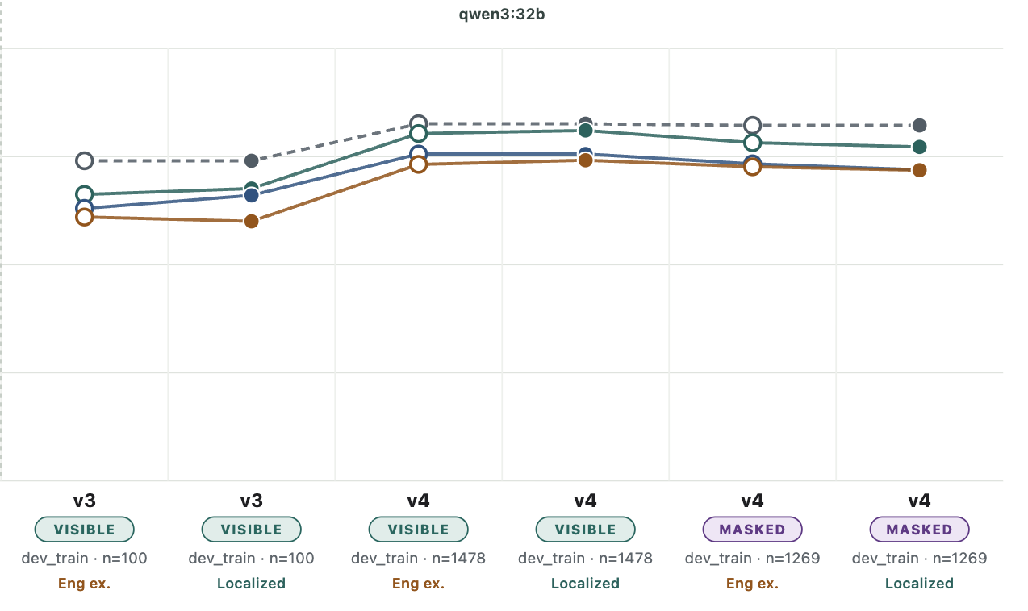
Spanish Denial vs. not denial

Slide 42
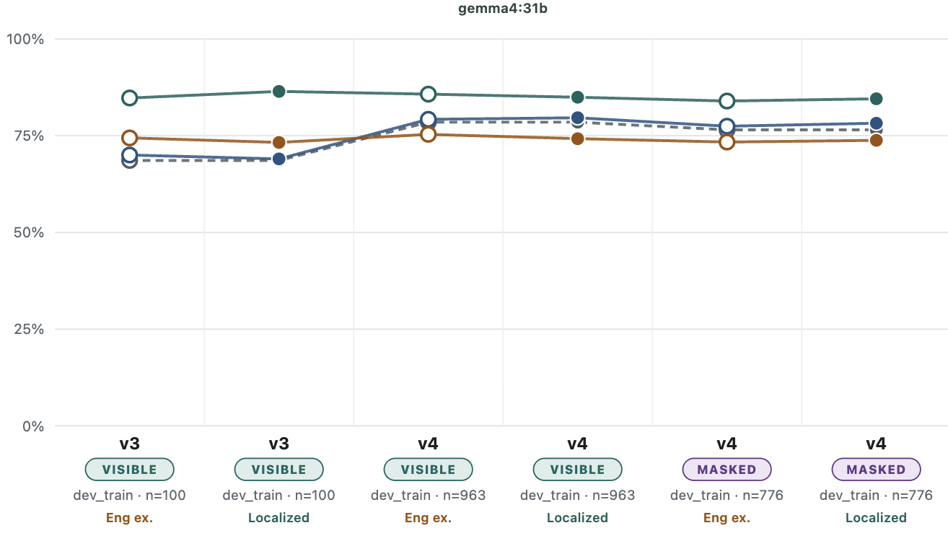
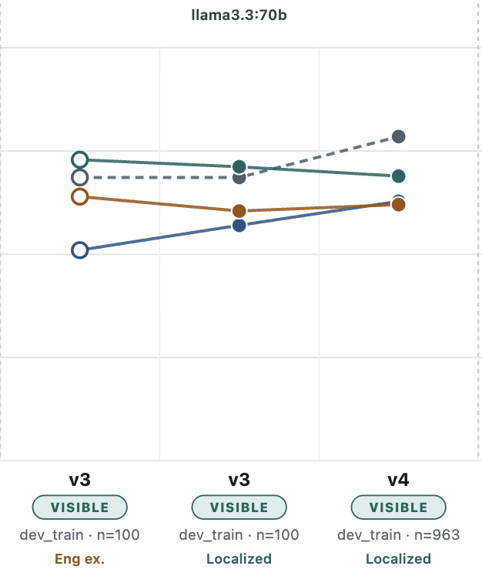
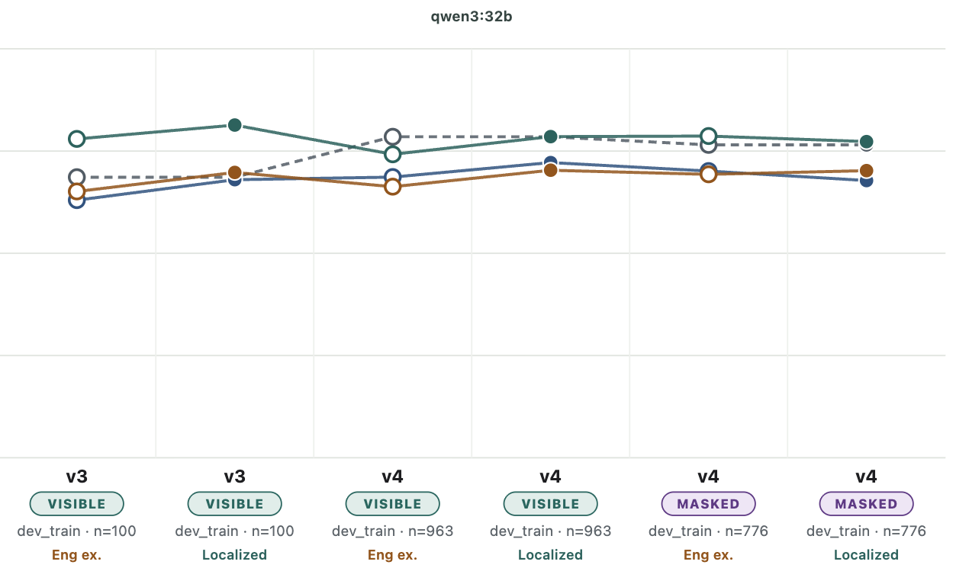
Hebrew all categories

Slide 43
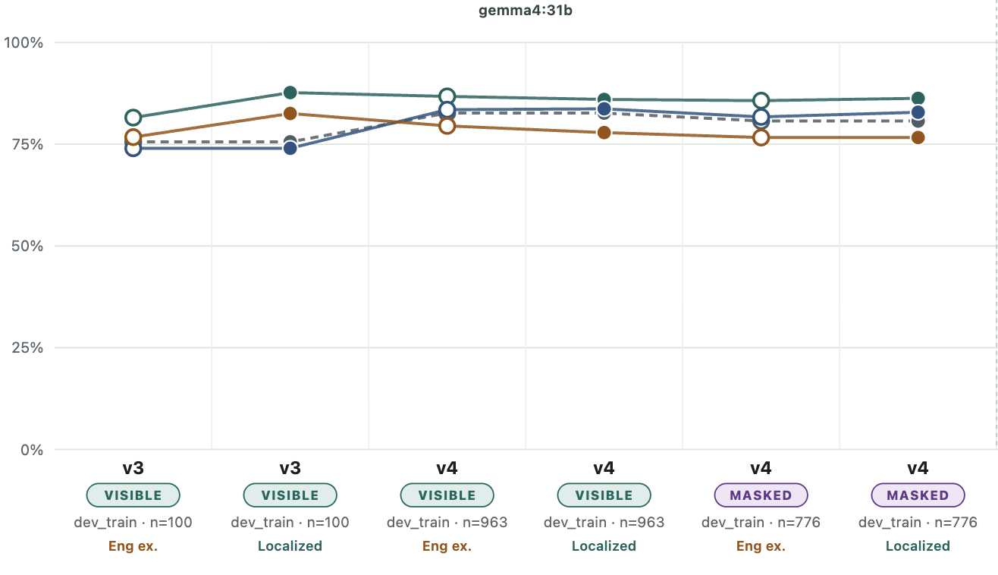
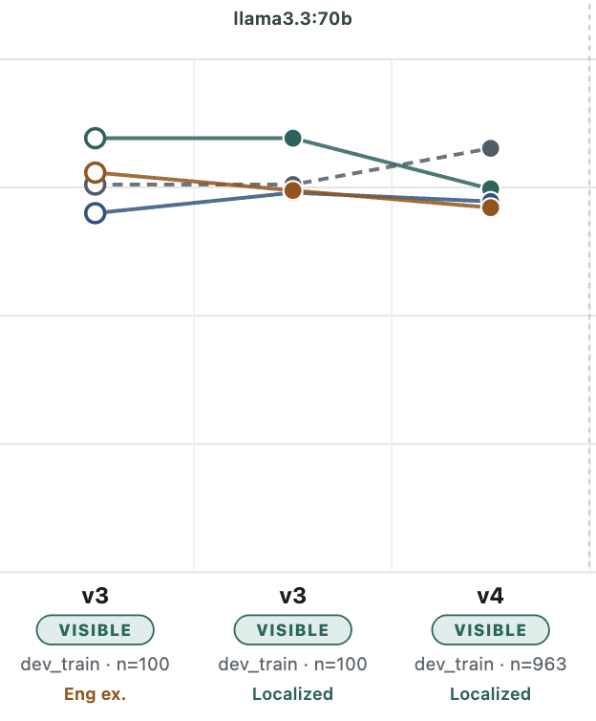
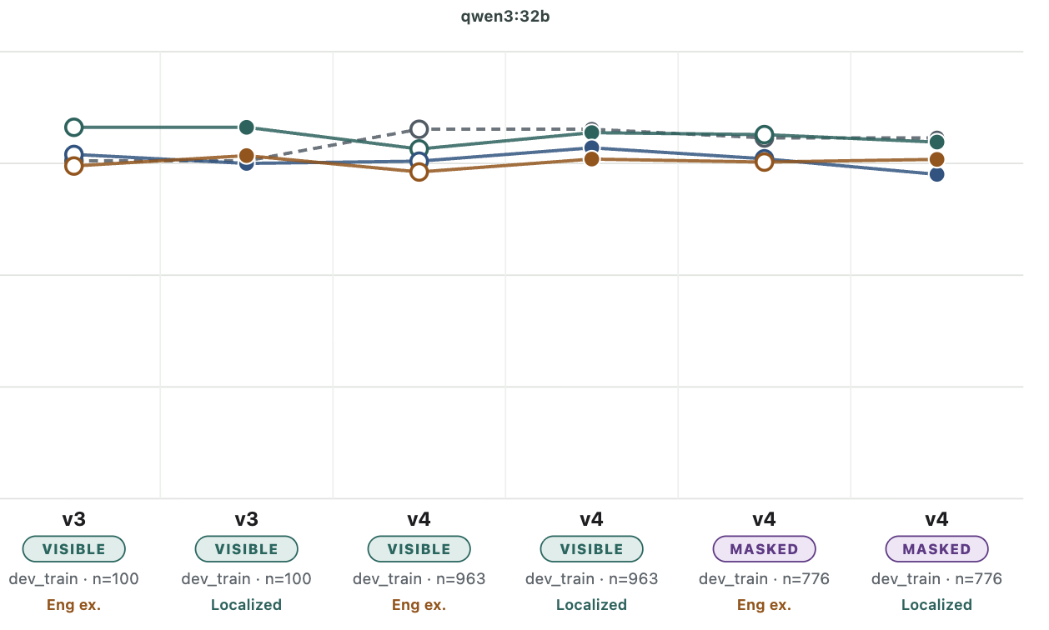
Hebrew Denial vs. not denial

Slide 44
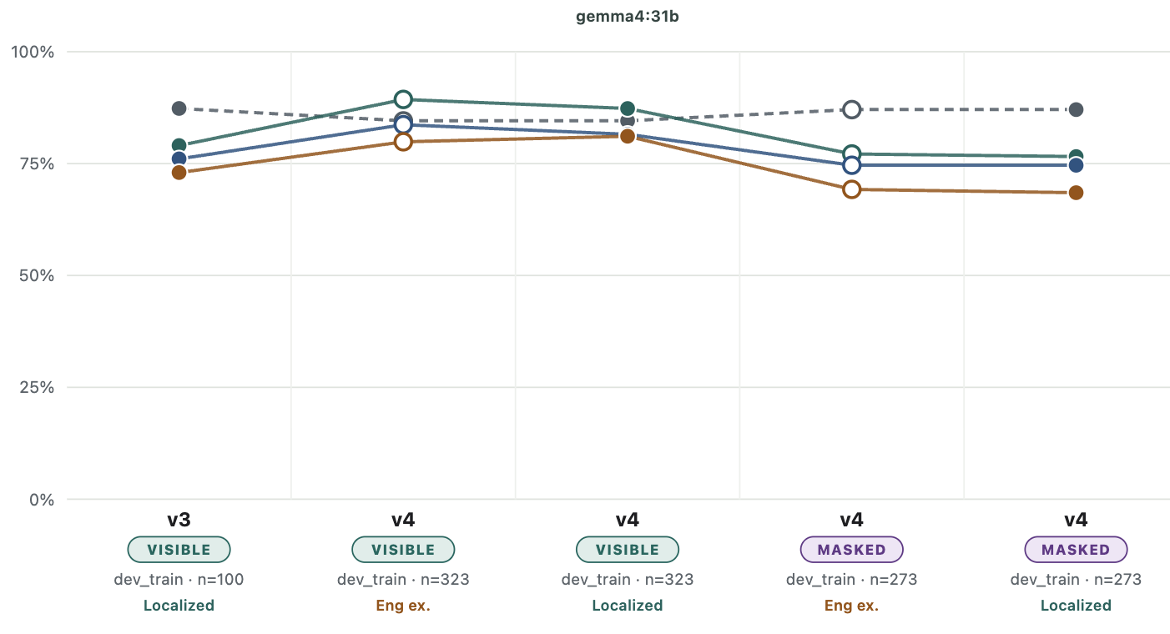
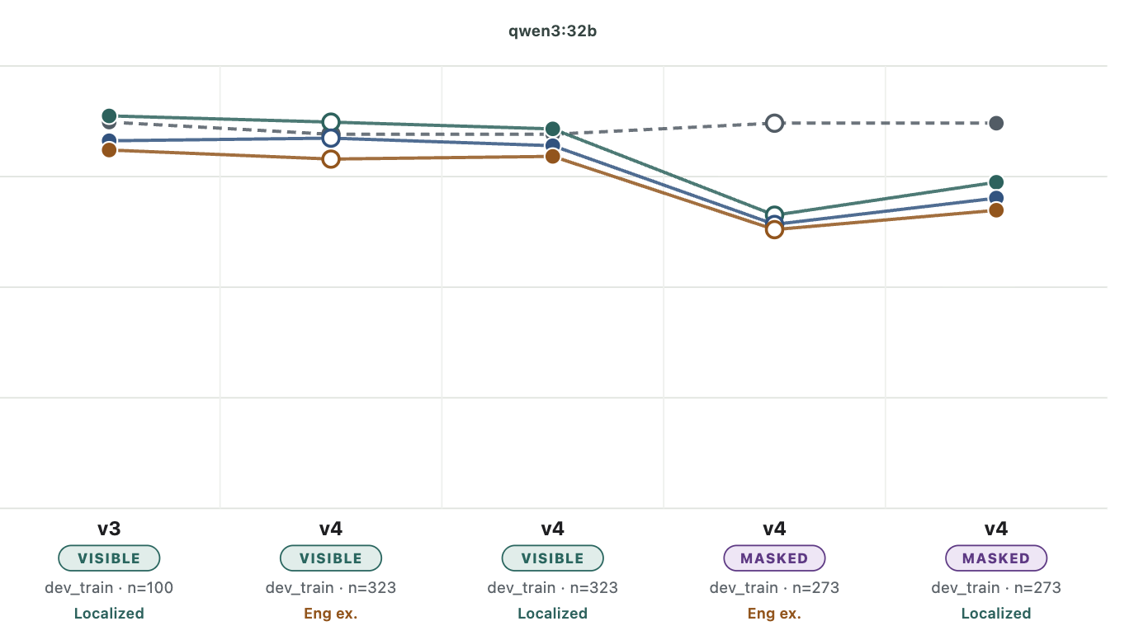
Tagalog all categories

Slide 45
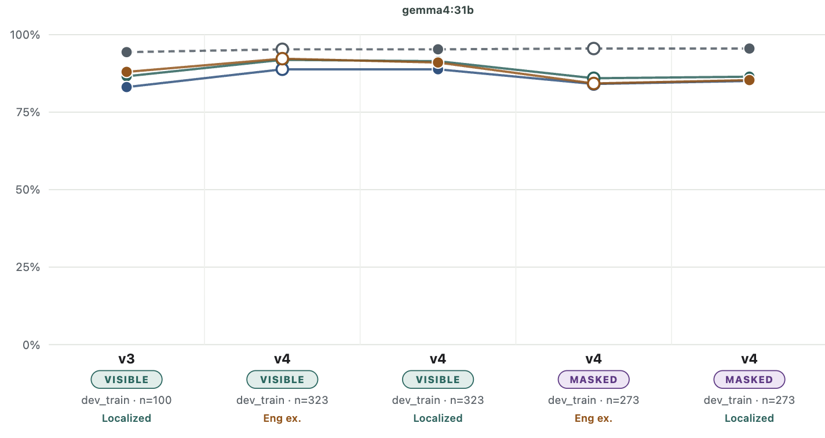
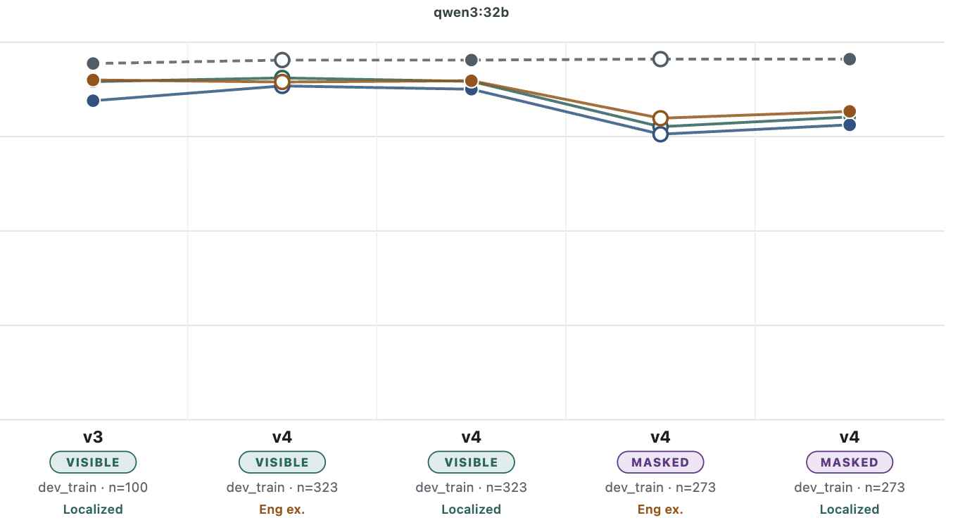
Tagalog Denial vs. not denial

Slide 46

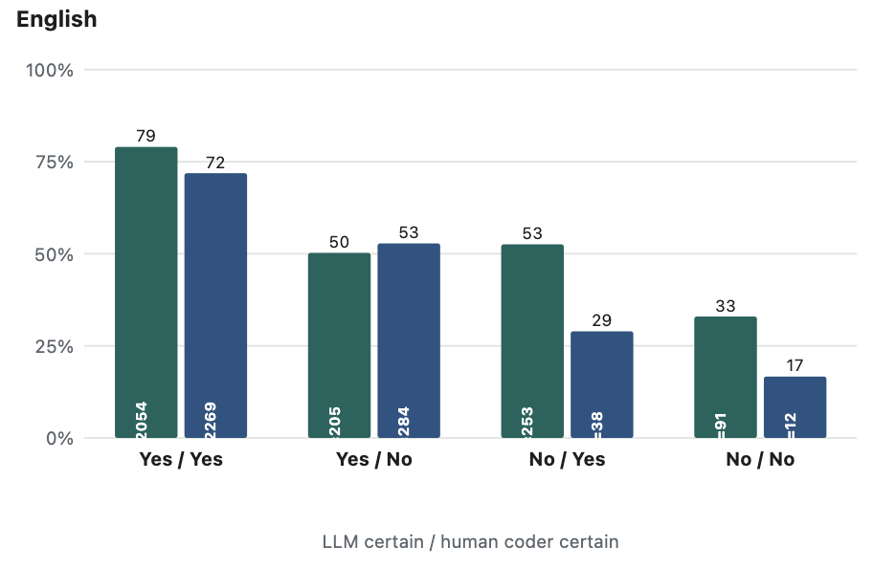
Certainty x agreement

Slide 47
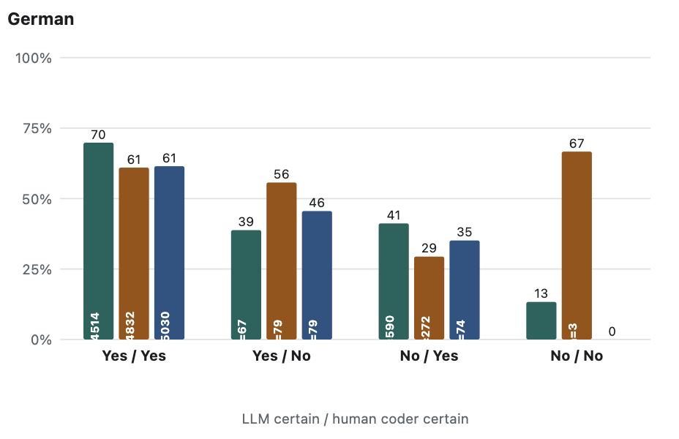
Certainty x agreement

Slide 48
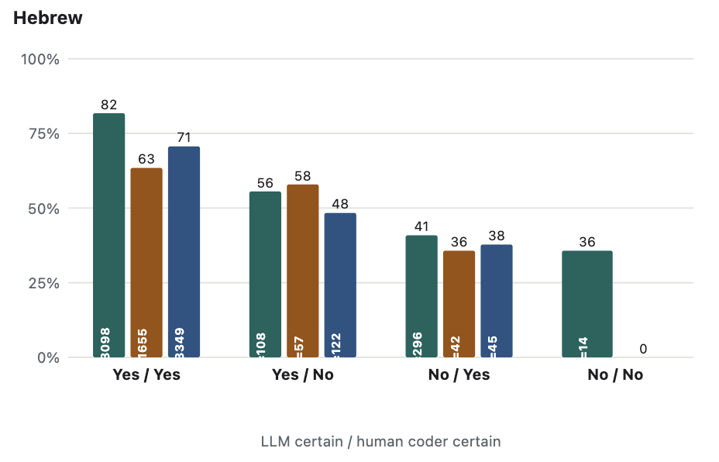
Certainty x agreement

Slide 49
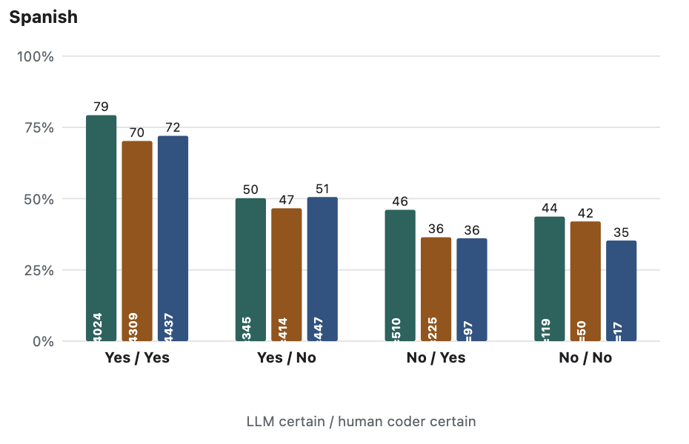
Certainty x agreement

Slide 50

Certainty x agreement

Slide 51
Questions
Is this coherent?
What models to use with other languages?
Tagalog!
Thinking? Right now they are
What is a realistic agreement target?

Slide 52

Prompt v1

Slide 53

Prompt v1

Slide 54

Prompt v1

Slide 55

Examples v1

Slide 56


LLM–human agreement across versions
Prompt contaminated
80 unseen lines

Slide 57
What changed: v1 → v2
Explain first, then label. v1 sometimes reasoned its way to the right answer but wrote down a different one. Now it must give its reasoning first, then pick the matching label
A clearer line between refusing and correcting. A child’s “no” can mean refusing something (“Want broccoli?” → “No!”) or saying something isn’t true (“That’s not a dog”). v1 called too much “refusing”; v2 reserves it for actually pushing back on a thing or action.
Handling “don’t…” commands. “Don’t do that” can mean stop an action (refusing) or restate a rule (correcting). v2 now tells these apart.
Keep real negations. v1 threw out some genuine “no”s as un-analyzable. v2 only sets one aside for clear reasons (singing, copying a grown-up) and otherwise marks it “unclear.”
Notice repeats. “No no no” is one idea said three times. v2 is now told each word’s position so it can flag the repeats.
Added worked examples — one for each kind of mistake v1 made.
BUT the added examples were precisely the lines to be coded -- lol

Slide 58

Prompt v2

Slide 59

Prompt v2

Slide 60

Prompt v2

Slide 61

Prompt v2

Slide 62

Examples v2

Slide 63

Examples v2

Slide 64
LLM–human agreement across versions
Prompt contaminated
80 unseen lines

Slide 65
What changed: v2 → v3
Why? v2 looked great, but it had been graded partly on its own examples. v3 keeps the real fixes, removes the unfair advantage, and tightens the last errors.
Let the conversation decide. The best clue to what a child’s “no” means is how the other person reacts: if the parent keeps pleading or bargaining, the child was refusing; if they correct a fact, the child was saying something’s untrue.
Spot requests hiding as statements. “You were going to put that away, okay?” is really a request — so answering “no” is refusing, not disagreeing with a fact.
Refusing during a back-and-forth. Saying “I don’t like it” while haggling over food is still a refusal, not a neutral opinion.
Make the model commit. Before writing its answers it now restates each one — closing the last cases where it reasoned one way but wrote another.
Lock the output format. The model is now technically prevented from inventing categories or writing an invalid answer.
Stop grading on the answer key (the big fix). v2’s examples were lifted from the test lines, so its score was inflated. v3 rewrites those examples in different words, drops the leaked lines from the score, and tests on fresh, unseen data.

Slide 66
Origins of logical thought: Two opposing views
No logical thought without language
Logical thought necessarily precedes language
E.g., Davidson, Bermudez
E.g., Fodor
NEGATION
NEGATION
“no”
“no”
Notes:
Negation as a test case
Logical content
Abstract, compositional meaning
Empirically, it seems hard to learn!

Slide 67
Logical negation emerges late
No (denial)
Not
No (rejection)
No (nonexistence)
No (prohibition)
~ 15 months
~ 27 months
Rejection “Do you want some broccoli?” “No!”
Prohibition “Can I go to the park?” “No!”
Nonexistence “Is there any milk?” “No!”
Denial “Is Pluto a planet?” “No!”
Bloom, 1970
Notes:
Another reason that negation is a good case study is that it seems to be hard– children don’t produce “no” to mean denial, nor understand “no” or “not” to mean denial, until after their second birthday (according to much of the existing body of work)
One reason to think these are separate concepts is that kids express them long before denial; another reason is that they’re separate words in tagalog
Reasons to think early negation might be function-specific
They use it specifically, according to some accounts
They fail comprehension tasks until later
They hear no as a one-word rejection/prohibition, and it’s easier to identify in those contexts (hsp)

Slide 68
Specific functions may imply specific meanings
Context
“No!”
Children’s first uses of “no” seem to be function-specific
The concept is available to map to language
Lexicalized in some languages (e.g., Tagalog)
"no" can reject even when there isn’t obvious want in the linguistic context
Rejection/prohibition meanings are easier to identify in isolation (Gomes et al., 2023)
REJECT
NEG
want
Speech act: Rejection
Meaning: REJECTION
Speech act: Rejection
Meaning: NEGATION
Notes:
The argument is not ‘no must have the meaning rejection’, it’s ‘children likely hypothesize that no means rejection’
And further, that this hypothesis is likely in English, but not Tagalog

Slide 69
What makes negation hard?
No (denial)
Not
No (rejection)
No (nonexistence)
No (prohibition)
~ 15 months
~ 27 months
CONCEPT LEARNING
LANGUAGE LEARNING
Difficulty learning the concept NEGATION
Difficulty mapping NEGATION to language
Is language learning or concept learning the major bottleneck on children’s acquisition of negation?
Bloom, 1970
Notes:
Does the concept preced the language, or does the language precede the concept?

Slide 70
Language structure may scaffold concept acquisition
WANT : REJECT
ALLOWED : PROHIBITED
EXISTS : NONEXISTENCE
P : NEGATION ( P ) “No!”
REJECTION
NONEXISTENCE
NEGATION
PROHIBITION
??????
“no”
Bermudez (2003); Drozd (1995); Hummer, Wimmer, & Antes (1995) ); Pea (1980)
Notes:
1:00
Our argument is that this clustering of meanings might scaffold the process of concept acquisition, if that is what’s happening
So that could look something like a child noticing a sort of analogy: want has the same relationship to reject as allowed has to prohibited, and as exists has to nonexistence; then, they might abstract away from those specific concepts to discover that any proposition P and it’s negation are also in that same relation. To be very clear, this is not a mechanistically spelled out story, this is merely a way to give you an intuition for what this hypothesis might look like. This proposal has been made several times in the literature, and nobody has given a mechanistic account of how it might happen
The point is though that even without a mechanistic account, this class of proposals makes specific empirical predictions that we can test. In particular, it makes the following prediction:

Slide 71
Language structure may scaffold concept acquisition
English
Tagalog
REJECTION
NONEXISTENCE
REJECTION
NONEXISTENCE
PROHIBITION
NEGATION
PROHIBITION
NEGATION
“no”
“ayaw” “huwag” “wala” “hindi"
Notes:
1:00
In English, all of these specific negative concepts are expressed by a single word, “no”, and so the word ”no” offers a child a convenient pointer to just the concepts they need to be paying attention to in the process of learning negation. In contrast, in Tagalog each of these meanings is expressed by a different word, and so children learning Tagalog don’t get the same leg up in learning the concept negation

Slide 72

English
Tagalog
more shared negation meanings
fewer shared negation meanings
This side learns denial negation language earlier
This side learns negation faster
CONCEPT LEARNING
Learning the concept NEGATION is
scaffolded by mappings to REJECTION, NONEXISTENCE, and PROHIBITION
Notes:
In a perfect world we would have multiple languages in each category, so this is a starting point and we will want to eventually add to it
not can be used to express r, p, etc, but it must do so compositionally--ie by composing with want to express rejections-- this makes it less likely that not is mapped to a specific concept of rejection, etc.
We included both English and Spanish because we were additionally interested in the presence of a denial-only negator in a language with another multi-function negator, but with our current data it’s hard to get much foothold on that, so I’ll focus on the shared meanings for now, and I’ll briefly discuss the one-to-one negator question at the end/I’d be happy to talk more about that offline

Slide 73
Clustered meanings could inhibit mapping NEGATION to language
Children resist mapping new meanings to a word they have a meaning for (Casenheiser, 2005; Mazzocco, 1997)
Children have an easier time learning homophonous mappings when the meanings are syntactically or semantically distinct (Dautriche et al., 2018)
REJECTION
NONEXISTENCE
PROHIBITION
NEGATION
“no”

Slide 74
Clustered meanings could inhibit mapping NEGATION to language
REJECTION
NONEXISTENCE
REJECTION
NONEXISTENCE
PROHIBITION
NEGATION
PROHIBITION
NEGATION
“no”
“ayaw” “huwag” “wala” “hindi"

Slide 75
English
Tagalog
more shared negation meanings
fewer shared negation meanings
This side learns denial negation language earlier
This side learns denial negation language earlier
This side learns negation faster
CONCEPT LEARNING
LANGUAGE LEARNING
Learning the concept NEGATION is
scaffolded by mappings to REJECTION, NONEXISTENCE, and PROHIBITION
Learning the NEGATION meaning of words is
inhibited by mappings to REJECTION, NONEXISTENCE, and PROHIBITION
Notes:
In a perfect world we would have multiple languages in each category, so this is a starting point and we will want to eventually add to it
We included both English and Spanish because we were additionally interested in the presence of a denial-only negator in a language with another multi-function negator, but with our current data it’s hard to get much foothold on that, so I’ll focus on the shared meanings for now, and I’ll briefly discuss the one-to-one negator question at the end/I’d be happy to talk more about that offline

Slide 76
English
Tagalog
more shared negation meanings
fewer shared negation meanings
This side learns denial negation language earlier
This side learns denial negation language earlier
This side learns negation faster
CONCEPT LEARNING LIMIT
LANGUAGE LEARNING LIMIT
Notes:
In a perfect world we would have multiple languages in each category, so this is a starting point and we will want to eventually add to it
We included both English and Spanish because we were additionally interested in the presence of a denial-only negator in a language with another multi-function negator, but with our current data it’s hard to get much foothold on that, so I’ll focus on the shared meanings for now, and I’ll briefly discuss the one-to-one negator question at the end/I’d be happy to talk more about that offline

